Slide 1
2016 Volunteer Training
For NC Voter Registration Drives
Sept. 7, 2016
Emily Roland, Member Advocacy Coordinator NCHA
Ted Fitzgerald, Voter Outreach – Lead Specialist
NC State Board of Elections

Slide 2
NCHA
130+ hospitals in North Carolina
200,000+ hospital employees

Slide 3
Why Voter Registration?
Key legislative issues could impact your work and your community’s access to care
Lawmakers need to know we’re engaged
“Hospital Votes Matter” video
http://ncha-my.sharepoint.com/personal/mschribman_ncha_org/_layouts/15/guestaccess.aspx?guestaccesstoken=r6H6JFWVsn63RFGvlhIAPqNa7J1TfKmqTzAo%2bmSbp%2bE%3d&docid=0c90c902f1e1b42c3929a388366d175a1&rev=1
Notes:
Hospital employees know that their ability to offer critical services, like 24/7 emergency care, wellness services, and acute care for all, is tied to the work of elected leaders in Washington and in Raleigh.
Today, there are a number of key legislative issues that have the potential to impact access to patient care and support in communities across NC, and your ability as a hospital employee to care for your community.
But to keep policy-makers’ attention, they need to know we’re engaged.

Slide 4
Today’s Goals
You will learn:
The changes to the Voting Law (including new Court Ruling)
How to speak to voters and educate them on voting dates and methods
How to help any eligible voters complete their registration application
How to conduct a voter registration drive at your hospital

Slide 5
NEW 4th Circuit Court Ruling
Friday, July 29, 2016
“Therefore, we enjoin only the challenged provisions of SL 2013-381 regarding photo ID, early voting, same-day registration,
out-of-precinct voting, and preregistration.”
What does this mean?
The ruling prohibits NC from requiring photo ID, including for the November 2016 general election.
It restores the week of early voting.
It restores pre-registration for 16- and 17-year-olds.
It ensures that same-day registration and out-of-precinct voting will remain in effect.
300,000 people in NC voted this way in 2008
Notes:
Everyone by now has heard we had ID, then we didn’t. WE had registration at early voting, then it was gone, then back. Well, here’s the current rules!
What does this mean?
The ruling prohibits NC from requiring photo ID, including for the November 2016 general election.
It restores the week of early voting. (starting Oct. 20) – Previously there were only 10 days of early voting, now 17 (locations & dates depend on county)
It restores pre-registration for 16- and 17-year-olds.
It ensures that same-day registration and out-of-precinct voting will remain in effect.
300,000 people in NC voted this way in 2008!
•Over 52,000 out-of-precinct provisional ballots (on Election Day) were cast and counted .
•Over 250,000 people used same day registration during early voting, over half of them were first time voters.
There is still no straight ticket voting, but that was unchallenged.

Slide 6
Engaging with Voters
“I can help you register to vote!”
“Would you like information on early voting?”
  Provide a listing of approved early voting locations/dates/times
“I have updated election information…”
  Provide card as reminder for fall election
  You will no longer need to bring a photo ID to vote
  One-stop early voting once again available
“Have you moved since you last voted?”
  Offer to re-register, reassure that it will take 2 minutes, offer to read it to them (and fill it out) to assist – they must sign/date their own form!
Notes:
Any change in address, name, party – they need to re-register
There is no “online” way to register to vote – Must sign and mail in form
Do not register people for other states

Slide 7
One-Stop Early Voting (“Early Voting”)
Oct. 20 – Nov. 5
Locations and dates of one-stop early voting differ by county – visit your County Board of Elections website for more info
If individuals missed the registration deadline (Oct. 14) they can register in-person and vote at the one-stop early voting sites in their county.
Notes:
Why vote early?
Bad weather – it could rain on Election Day!
Avoid the rush and long lines on Election Day
Avoid missing work and losing pay – vote on the weekends during early voting!
You won’t forget to vote until it’s too late!
Any problems with your registration or address can be corrected during Early Voting. No changes are allowed on Election Day.

Slide 8
Registration Requirements
You must
Be a US citizen – born or naturalized
Be 18 years old by November 8 (pre-register 16 & 17 year olds)
Live at residence for at least 30 days before Election Day
Not be currently serving a felony sentence, be on probation or parole

Slide 9

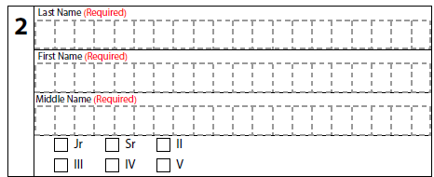
Voter Registration Application
Completing the Form: You may fill out the form for the voter, but the voter MUST sign and date.
Section 1: Needs to be completed or application will be declined.
Section 2: Fill out entire
name as it appears on ID,
including middle.

Slide 10
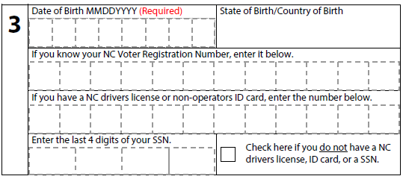
Voter Registration Application
Section 3: Date of birth required. Ask voter to provide EITHER Driver’s License Number OR last 4 digits of SSN. This is not required, but helps the Board of Elections verify voter’s identity.
Ask for ONE!
No longer relevant
Notes:
They do not need to SHOW you these items, just need to know one or the other
If someone leaves 3 blank, they may be asked to provide either a photo or non-photo ID when they present to vote for the first time. This is only in the event the County Board of Elections is unable to verify their identity or address from the information provided on the form during the registration process. A nonphoto ID can be a current bank statement, utility bill, or any government document with the person’s name and current address.

Slide 11
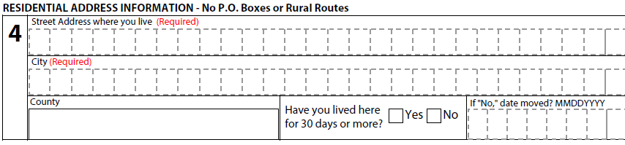
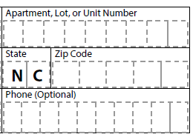
Voter Registration Application
Section 4: Residential address must be a physical place, not a post office box!
Moved since last voted?: Use new residential address
Phone number: Not required, but
BoE can call voter if something
is wrong with form.
Notes:
“have you lived here for 30 days or more ….prior to election day” – you can leave this blank
”Do you receive mail here?”
COLLEGE STUDENTS – SEE NEXT SLIDE
When registering students living on campus, please ask them to be as specific as possible with their physical address. Some precinct or office lines split campus buildings.

Slide 12
Voter Registration Application
College Students
Where you register and vote depends on where you call “home.”
Call your college community your home if you do not have a clear “intent to return” to another place, like your parent’s address, after you graduate.
If you clearly intend to return to your parent’s address after graduation, then register with their address as your home. [NC General Statute 163-57(2)11]
If you have no clear plan about where you will next live, you may choose either address. Make a choice, but be sure that you do not vote in both places!
Update your registration if you move. Notify officials to remove your name at the old address.
Notes:
When registering students living on campus, please ask them to be as specific as possible with their physical address. Some precinct or office lines split campus buildings.

Slide 13
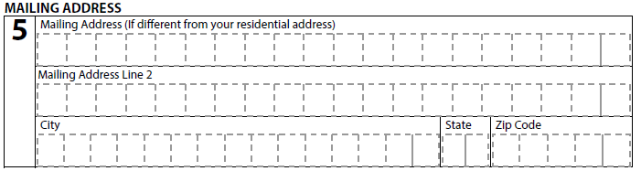
Voter Registration Application
Section 5: Mailing address may be different than residential address. If mail goes to a PO Box, include both mailing and residential addresses.
A confirmation card with the voter’s poling location will be mailed from BoE in approx. 2 weeks. If not able to be delivered, the BoE will not process the registration.
Notes:
Mailing address does not have to be in NC

Slide 14
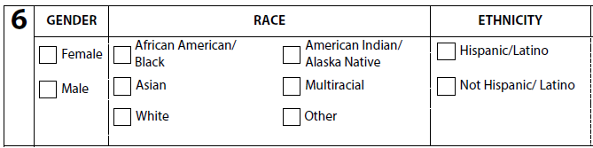
Voter Registration Application
Section 6: Not required, but provides demographic information for districting, funding allocations, etc.
Tip: Ask the voter to complete this portion of the application themselves, so as not to make any assumptions.

Slide 15
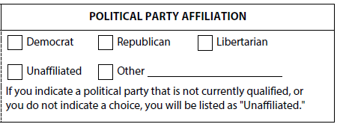
Voter Registration Application
PARTY: Voter can choose a party, but if they don’t, the BoE will assign them “Unaffiliated.” Unaffiliated voters can vote in the primary and choose a party ballot.
Tip: This is where you
may get some commentary.
DO NOT ENGAGE – Remember, you must remain non-partisan. Do not discuss political party affiliation, issues or candidates.
Notes:
FYI:
Affiliated voters are required to vote the ballot for their party during a partisan primary.
Unaffiliated voters can choose either party’s ballot during a partisan primary.

Slide 16
Voter Registration Application
Section 7: You can leave blank, unless they have recently moved. This registration application cancels prior registrations.
Sign & Date: Make sure it is signed by voter and dated. Even an “X” counts as a signature.
Double check all essential elements are completed and remind applicants to look for the card from the BoE in the mail with polling location in approx. 2 weeks.

Slide 17
Voter Registration Laws
It is illegal to in any way alter or forge a voter registration application. Examples:
Never fill out missing information after the voter signs.
Neither you nor voter can sign a form on behalf of another person.
Neither you nor voter can complete or let anyone complete a form on behalf of relative or friend.
Neither you nor voter can make up information.
You can never offer anything of value to complete an application form. If a “treat” is offered at your registration table, it must be “Free for Everyone” (signage is encouraged).

Slide 18
Returning Voter Reg Forms to BOE
All voter registration applications provided to you as part of registration drive must be mailed/delivered to the Board of Elections
    Tip: Deliver to BoE within 5 days of drive
    By Law: Must deliver to BoE no later than
    Oct. 14 registration deadline
Mail is no longer automatically postmarked. If mailing by the deadline (Oct. 14), make sure the post office postmarks the envelope.
You must turn in all applications collected, even incomplete ones.

Slide 19
Confidentiality
The information you collect is confidential and you agree not to retain any information from the forms once you have collected them. You will not disclose records to anyone unless required to do so under the law.

Slide 20
Non-Partisan
During your voter registration drive at the hospital, you are engaging in non-partisan activities and cannot express any opinion in favor or opposition to a candidate, a party or an issue.
You cannot refuse to offer an eligible voter an application.
You cannot refuse to accept an application of an eligible voter.

Slide 21
Preparing for the Drive - Publicize
CEO memo to hospital employees
Internal newsletters to staff
“Hospital Votes Matter” video on intranet
Press release
Social media #HospitalVotesMatter
Templates can be found at:
https://www.ncha.org/advocacy/grassroots-advocacy/grassroots-coordinators

Slide 22
Preparing for the Drive - Materials
Table & chairs reserved in high traffic area (cafeteria, lobby)
Voter registration forms (contact your County Board of Elections)
Clipboard (w/ signage on back “Register to Vote Here”)
Pens
Healthy snacks/goodies (w/ “Free for Everyone” signage)
Smartphone for voter/polling place lookup
Large Signage: Register to Vote Here
Envelope/box for completed registration forms
Video/laptop: “Hospital Votes Matter” video
Contact info of someone at the Hospital volunteers can contact with questions/concerns during the drive
Materials on NCHA website: - https://www.ncha.org/advocacy/grassroots-advocacy/grassroots-coordinators
  - Cards/fliers to distribute with general voter information
  - Sample scripts & FAQs for volunteers to review
  - Stickers “Hospital Votes Matter – I Vote!”
  - Selfie props

Slide 23
Do
Smile
Ask voter to make sure info is correct before they sign
Encourage voter to complete the form on-site and leave it with you, but if they prefer to take it with them they can
Return all completed forms to the Board of Elections within 5 days of the drive
Share feedback and details with your hospital’s organizer
Remain non-partisan

Slide 24
Don’t
Don’t wear buttons, hats or t-shirts with candidate, campaign, party or issues on them.
Don’t ever engage in partisan conversations on candidates, parties or issues.
Never argue with a voter – smile and walk away.
Never keep completed (or partially completed) forms.
Never make up information – If you don’t know, say “I don’t know” and call your hospital contact.
Don’t press someone if they do not want to register, respect their wish.
Notes:
If someone does not want to register, respect their wish and do not press them. They may have a reason they want to keep private. For example, they may still be serving a felony sentence, or may not be a citizen.

Slide 25
Thank You!

