Slide 1
Mental Health Prevalence Perception and Stigma
Serving Durham, Wake, Cumberland and Johnston Counties

Slide 2
James Osborn, LPA, LCAS
Director of Community Education and Outreach
(919) 651-8440
josborn@AllianceBHC.org

Slide 3
Who is Alliance?
A Local Management Entity (LME) and Managed Care Organization (MCO) – LME/MCO
Serving Cumberland, Durham, Johnston, Wake
Authorize, pay, and manage Medicaid, State and locally-funded
24/7/365 access to information and access to behavioral health
Notes:
This slide highlights the latest changes as part of mental health reform
Although we are not the largest MCO in terms of geography we are the largest MCO based on population with over 187,00 people who are Medicaid eligible
Unlike our role as an LME we are now responsible to authorize and pay for services- used to be done by a statewide vendor. Allows us to detect the utilization of certain services that are high cost and any service gaps or trends
The public behavioral health Managed Care Organization (MCO) serving the people of Durham, Wake, Cumberland and Johnston counties
Responsible for authorizing and paying for Medicaid, State and locally-funded services
Provides 24/7 information and access to mental health, substance abuse and developmental disability services and supports

Slide 4
Help & Information available 24/7 every day
800-510-9132
Notes:
HELP & INFORMATION AVAILABLE 24/7 EVERY DAY: 800-510-9132
Promoting recovery in Cumberland, Durham, Johnston and Wake Counties
Pass out the Alliance Crisis Cards, business cards, and/or brochures.

Slide 5
Why Behavioral Health?
Mental health problems are common
Stigma is associated with mental health problems
Many people are not well informed
Professional help is not always on hand
People often do not know how to respond
People with mental health problems often do not seek help
WHY MENTAL HEALTH FIRST AID?
Notes:
Pass out the Mental Health Opinion Quiz – 10 minutes – use Kahoot

Slide 6
WHY MENTAL HEALTH FIRST AID?
Notes:
Pass out the Mental Health Opinion Quiz – 10 minutes – use Kahoot

Slide 7
U.S. Adults with a Mental Disorder
in Any One Year
Type of Mental Disorder | % Adults
Anxiety disorder | 18.1 .
Major depressive disorder | 6.8 .
Substance use disorder | 8.1
Bipolar disorder | 2.8 .
Eating disorders | 5-10 .
Schizophrenia | 0.3 – 0.7 .
Any mental disorder | 18.5 .
Only 41% of people with a mental illness use mental health services in any given year

Slide 8
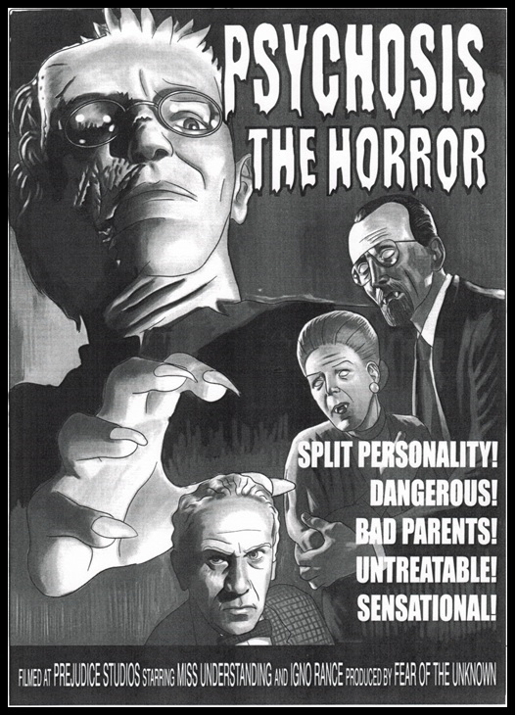
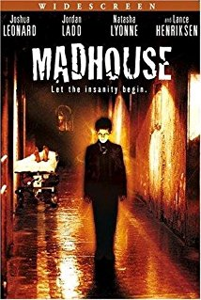
Notes:
Media’s Damaging Depictions of Mental Illness

Slide 9
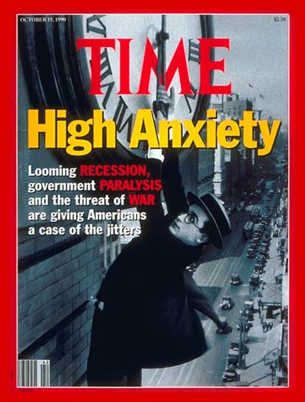
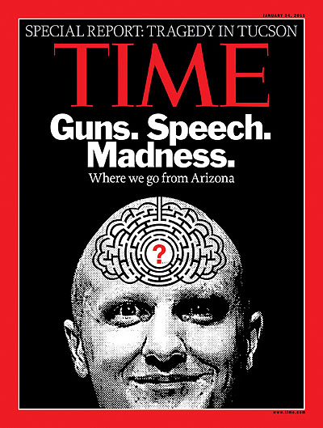
Notes:
Media’s Damaging Depictions of Mental Illness

Slide 10
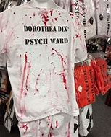
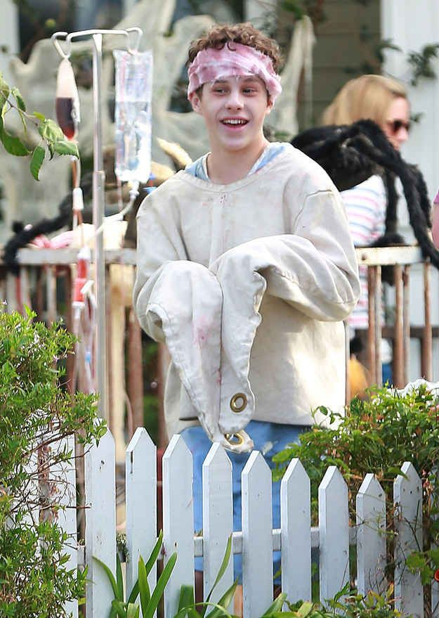
Notes:
Media’s Damaging Depictions of Mental Illness
The Halloween costume in the bottom left was being sold in a Halloween shop at the Triangle Town Center a couple of years ago. NAMI Wake advocated for the removal. The costume was pulled from the shelf.
Language can be everything!
Stigma
A set of negative and often unfair beliefs that a group of people have about something
It’s about disrespect and using negative labels to identify a person living with behavioral illness
Prevents people from reaching out for the help that they need and deserve
Many people would rather tell employers they served time in jail than admit to being in a psychiatric hospital?
Stigma
Leads to fear, mistrust and violence against people living with behavioral illness and their families?
Can cause families and friends to turn their backs on people with behavioral illness?
Can result in inadequate insurance coverage for behavioral health services?
Is about disrespect and using negative labels to identify a person living with behavioral illness?

Slide 11
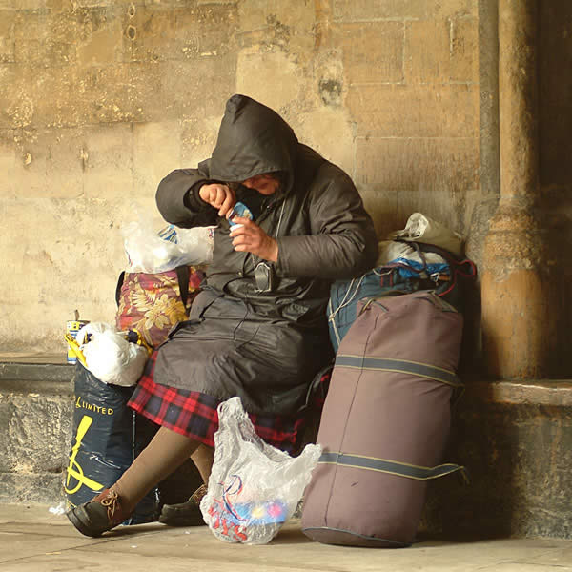
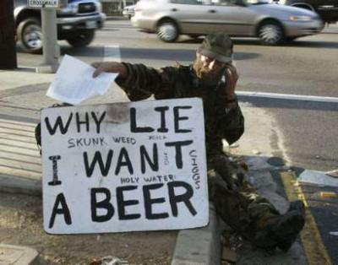
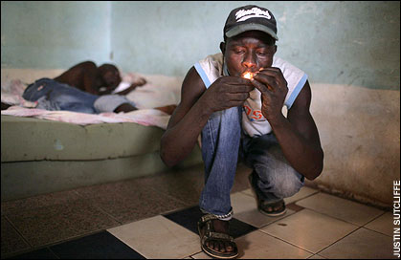
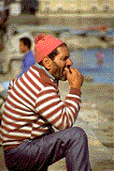
Are these the faces of mental illness
and substance use disorders?

Slide 12
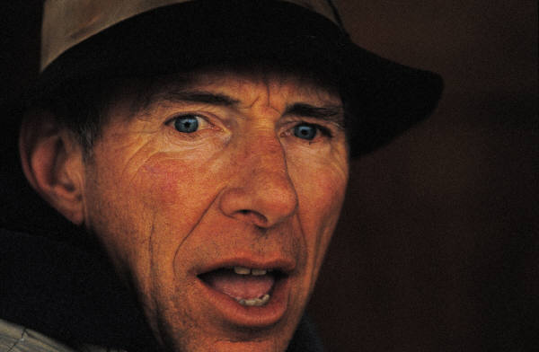
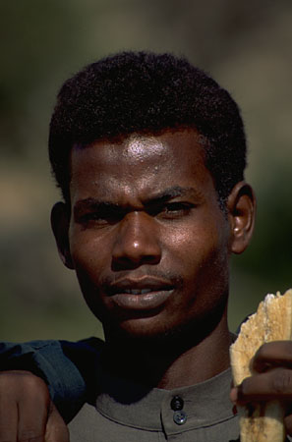
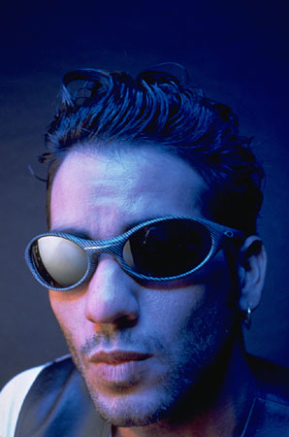
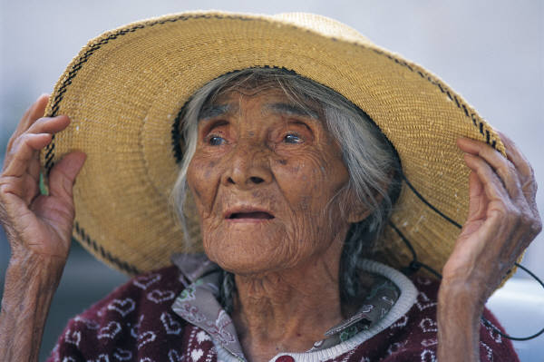
Or are these?
Serving Durham, Wake, Cumberland and Johnston Counties
Notes:
Are these the faces of mental illness and addictive disorders?
Young or old, Rich or poor, well groomed or not - race, color, religion, sex, national origin, age, handicap, sexual orientation or marital status. There is no discrimination. Equal Opportunistic Disease.
How can you tell someone has mental illness? You can not. Hidden Disease
NAMI – Mental Illness affects 1 in 4 or nearly 60 million Americans every year. 1 in 4 adults experience mental illness. 1 in 5 children experience mental illness.
Almost 8.4 million U.S. children ages 9 to 17, or one out of five children and adolescents, suffer from some form of mental, emotional, or behavioral challenges. http://awarenessweek.ffcmh.org/briefing

Slide 13
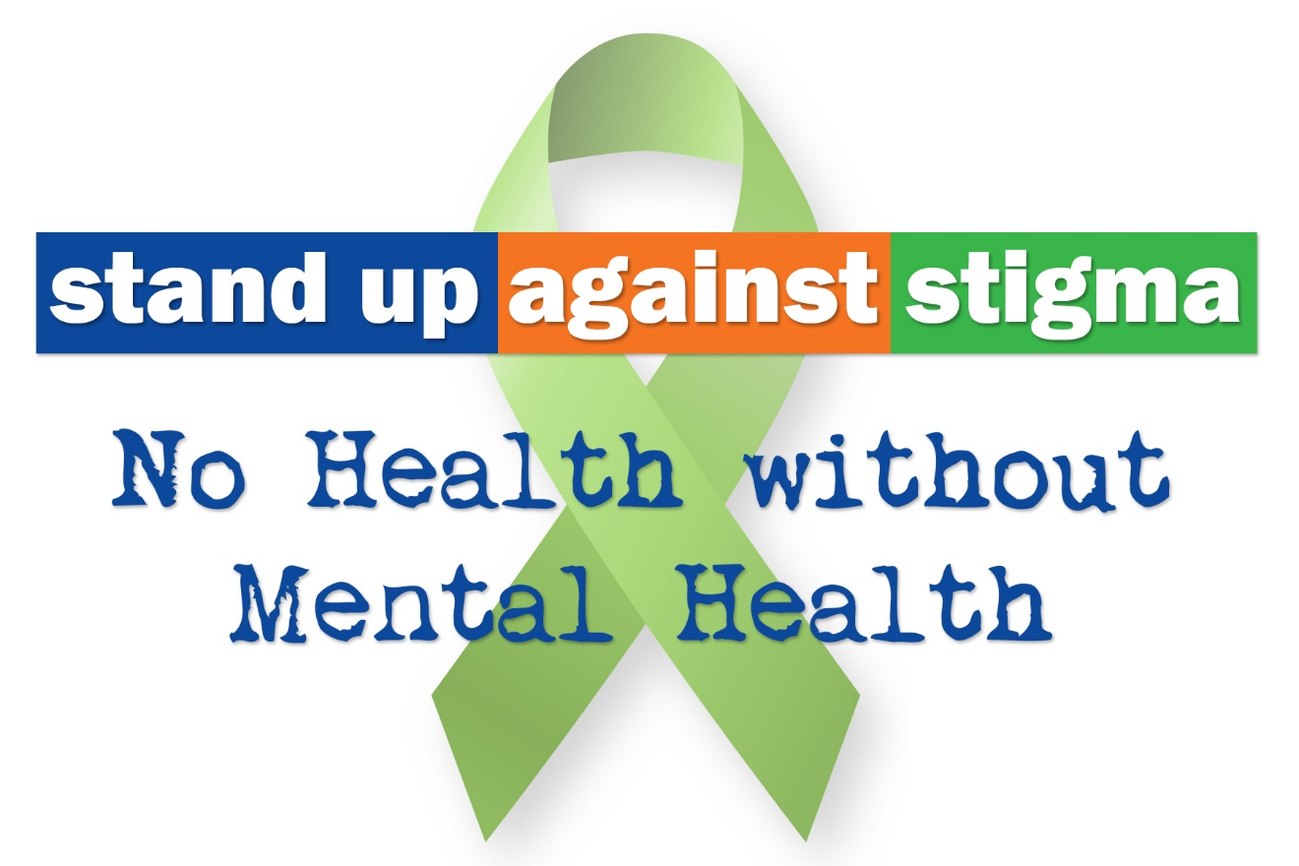
Notes:
Fighting Stigma
Become more aware – learn the truth
Use respectful language
Tell someone if they express a stigmatizing attitude
Emphasize abilities, not limitations
Share resources from the Alliance Re-Think toolkit!
Request printed materials from our Community Relations team.
Add our link to your website!
Mental Health Awareness is represented by a green ribbon. In the 1800s, green was the color used to label people who were considered “insane”.

Slide 14
The Re-Think Campaign
Notes:
Focuses on the concepts of recovery and self-determination
Designed to counter the misconceptions and myths that keep people from getting the help they need
Stigma – is created by misconceptions and myths about MH/DD/SA. Creates barriers to accessing care.

Slide 15
Why Behavioral Health?
“Disability” refers to the amount of disruption a health problem causes to a person’s ability to:
Work
Carry out daily activities
Engage in satisfying relationships
Mental illnesses can be more disabling than many chronic physical illnesses. For example:
The disability from moderate depression is similar to the impact from relapsing multiple sclerosis, severe asthma, or chronic hepatitis B.
The disability from severe depression is comparable to the disability from quadriplegia.
IMPACT
3
Notes:
Activity: The Disability Weighted Exercise – Time 15 minutes
Work, Daily Activity, Relationship OR Live, Love, Laugh OR OIL – Occupation, Interpersonal, Living

Slide 16
For more information, please contact:
James Osborn, LPA, LCAS
Director of Community Education and Outreach
(919) 651-8440
josborn@AllianceBHC.org

