Slide 1
Behavioral Health
Depression and Anxiety
Serving Durham, Wake, Cumberland and Johnston Counties
Notes:
We are talking about Behavioral Health. This umbrella term include: mental health/illness (MH or MI), substance use disorders (SUDS), and intellectual disabilities and developmental disabilities. (IDD). MH/MI may also be called SPMI – Severe Persistent Mental Illness. IDD use to be DD for Developmental Disabilities.
Types of Mental Health Disorders
Mood Disorders
Anxiety Disorders
Psychotic Disorders
Personality Disorders
Today I am going to be talking a Mood disorder – depression, anxiety disorders, psychosis, and SUDS.

Slide 2
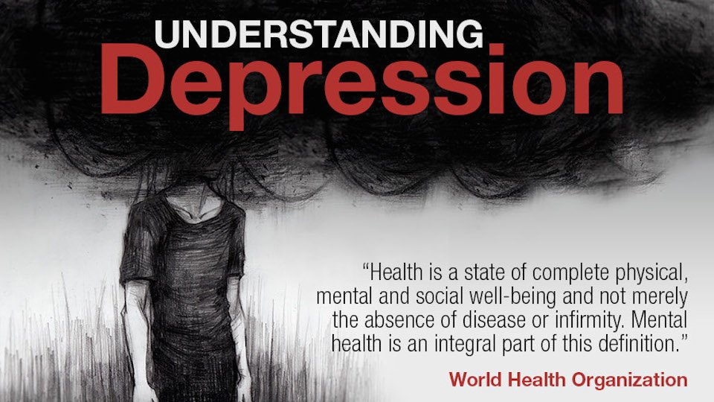
TYPES OF MOOD DISORDERS
Notes:
Depression Section
Read the quote – We have separated and treated the head differently from the body. We are now moving to an integrated care model – Whole Person Care.
Alliance Vision - To be a leader in transforming the delivery of whole person care in the public sector.
Major depressive disorder lasts for at least 2 weeks and affects a person’s
Emotions, thinking, behavior, and physical well-being
The emotions = heart. Thinking = head. Behavior = do/signs.
Signs and symptoms
Suffer in silence with symptoms only
The signs and symptoms are on a continuum – low, moderate, or high
Ability to work and have satisfying relationships
Ability to carry out usual daily activities

Slide 3
TYPES OF MOOD DISORDERS
Notes:
The Illness-Wellness Continuum is a graphic illustration of a wellbeing concept first proposed by John W. Travis in 1972. It describes how wellbeing is more than simply an absence of illness, but also incorporates the individual's mental and emotional health. In this it echoes the view of the World Health Organization.
http://www.thewellspring.com/wellspring/introduction-to-wellness/357/key-concept-1-the-illnesswellness-continuum.cfm
Major depressive disorder lasts for at least 2 weeks and affects a person’s
Emotions, thinking, behavior, and physical well-being
The emotions = heart. Thinking = head. Behavior = do/signs.
Signs and symptoms
Suffer in silence with symptoms only
The signs and symptoms are on a continuum – low, moderate, or high
AND
Ability to work and have satisfying relationships
Ability to carry out usual daily activities
_________________________________________________________________________________________________________________________________________________________________________
Wellness is a process, never a static state. Most of us think of wellness in terms of illness; we assume that the absence of illness indicates wellness. There are actually many degrees of wellness, just as there are many degrees of illness. The Illness-Wellness Continuum illustrates the relationship of the treatment paradigm to the wellness paradigm.
Moving from the center to the left shows a progressively worsening state of health. Moving to the right of center indicates increasing levels of health and wellbeing. The treatment paradigm (drugs, herbs, surgery, psychotherapy, acupuncture, and so on) can bring you up to the neutral point, where the symptoms of disease have been alleviated. The wellness paradigm, which can be utilized at any point on the continuum, helps you move toward higher levels of wellness. The wellness paradigm directs you beyond neutral and encourages you to move as far to the right as possible. It is not meant to replace the treatment paradigm on the left side of the continuum, but to work in harmony with it. If you are ill, then treatment is important, but don't stop at the neutral point. Use the wellness paradigm to move toward high-level wellness.
Even though people often lack physical symptoms, they may still be bored, depressed, tense, anxious, or simply unhappy with their lives. Such emotional states often set the stage for physical and mental disease. Even cancer can be brought on by excessive stress that weakens the immune system. Negative emotional states can also lead to abuse of the body through smoking, overdrinking alcohol, and overeating - attempts to substitute for other more basic human needs such as acknowledgment and respect, a stimulating and supportive environment, and a sense of purpose and meaning.
Wellness is not a static state. High-level wellness involves giving good care to your physical self, using your mind constructively, expressing your emotions effectively, being creatively involved with those around you, and being concerned about your physical, psychological, and spiritual environments. In fact, it's not so much where you are on the continuum, but which direction you're facing. High-level wellness does not preclude periods of illness and weakness, nor does it attempt to deny that death is a natural part of life. (As you'll find in the section Wellness and Finding Meaning, dying can be done from a place of wellness). Awareness of this paradox eventually led us to expand the model, but first a little background.
The Illness-Wellness Continuum was first envisioned by John in 1972, late one evening after everyone else at his office in the U.S. Public Health Service Hospital in Baltimore, Maryland, had gone home. It was a melding of the health risk continuum created by Lewis Robbins (creator of the Health Risk Appraisal) and Abraham Maslow's concept of self-actualization.
Once it was published in 1975, the continuum became an immediate success, an easy way to illustrate what this newly emerging wellness concept was all about. Health practitioners and educators began using it; soon it was appearing in books, journals, and slide presentations everywhere around the world. We naturally included it in the first edition of this book, and we continue to do so because of its visual impact. To this day it is reprinted in health and medical textbooks worldwide.
However, a simple model cannot always convey a complex concept. For a number of years we had recognized that the continuum could be misleading in one very significant area. We knew it is possible to be physically ill yet oriented toward wellness, or to be physically healthy yet functioning from an illness mentality. Our one-dimensional model simply couldn't show this distinction. For example, imagine disabled, sick, or dying people who are taking responsibility for their lives and are consciously engaged in the experience. If only the physical dimension were considered, they would fall on the left side of the continuum, but if emotional, intellectual, and spiritual dimensions are taken into account they would definitely be on the right side of the continuum.

Slide 4
Check Your OIL
Occupation
Interpersonal
Living
Notes:
Live, Work, Play
Live, Love, Laugh
OIL – occupation, interpersonal, living
Ability to work and have satisfying relationships
Ability to carry out usual daily activities

Slide 5
Depression: Signs and Symptoms
Physical
Fatigue
Lack of energy
Sleeping too much or too little
Overeating or loss of appetite
Constipation
Weight loss or gain
Headaches
Irregular menstrual cycle
Loss of sexual desire
Unexplained aches and pains
Behavioral
Crying spells
Withdrawal from others
Neglect of responsibilities
Loss of interest in personal appearance
Loss of motivation
Slow movement
Use of drugs and alcohol
Notes:
With all disorders, there are three areas of impact:
Physical
Behavioral
Psychological
In the assessment process for behavioral health, rule out physiological causes, then substance induced, and then determine the mental illness. Depression -
Differential Diagnosis Mood disorders are sometimes caused by general medical conditions or medications. Classic examples include the depressive syndromes associated with dominant hemispheric strokes, hypothyroidism, Cushing’s disease, and pancreatic cancer (DSM-IV). Among medications associated with depression, antihypertensives and oral contraceptives are the most frequent examples. Transient depressive syndromes are also common during withdrawal from alcohol and various other drugs of abuse.
Types of Mental Health Disorders
Mood Disorders
Anxiety Disorders
Psychotic Disorders
Personality Disorders

Slide 6
Depression: Signs and Symptoms
Psychological
Sadness
Anxiety
Guilt
Anger
Mood swings
Lack of emotional responsiveness
Feelings of helplessness
Hopelessness
Irritability
Frequent self-criticism
Self-blame
Pessimism
Impaired memory and concentration
Indecisiveness and confusion
Tendency to believe others see one in a negative light
Thoughts of death and suicide
Notes:
Types of Depressive Disorders
Major depressive disorder
Bipolar disorder
Postpartum depression
Seasonal depression
Types of Mental Health Disorders
Mood Disorders
Anxiety Disorders
Psychotic Disorders
Personality Disorders

Slide 7
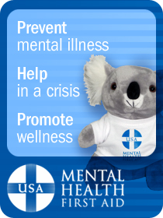
Video - Pain of Depression
Notes:
Watch Video on Depression writing down the physical, behavioral, and psychological s/s observed.
Types of Depressive Disorders
Major depressive disorder
Bipolar disorder
Postpartum depression
Seasonal depression
Types of Mental Health Disorders
Mood Disorders
Anxiety Disorders
Psychotic Disorders
Personality Disorders

Slide 8
TYPES OF MOOD DISORDERS
Notes:
Depression
"That's the thing about depression: A human being can survive almost anything, as long as she sees the end in sight. But depression is so insidious, and it compounds daily, that it's impossible to ever see the end. The fog is like a cage without a key." -Elizabeth Wurtzel, Prozac Nation
(Elizabeth Lee Wurtzel (born July 31, 1967)^{[1]} is an American writer and journalist, known for publishing her best-selling memoir Prozac Nation, at the age of 26. She holds a BA in comparative literature^{[2]} from Harvard College and a JD from Yale Law School.)

Slide 9
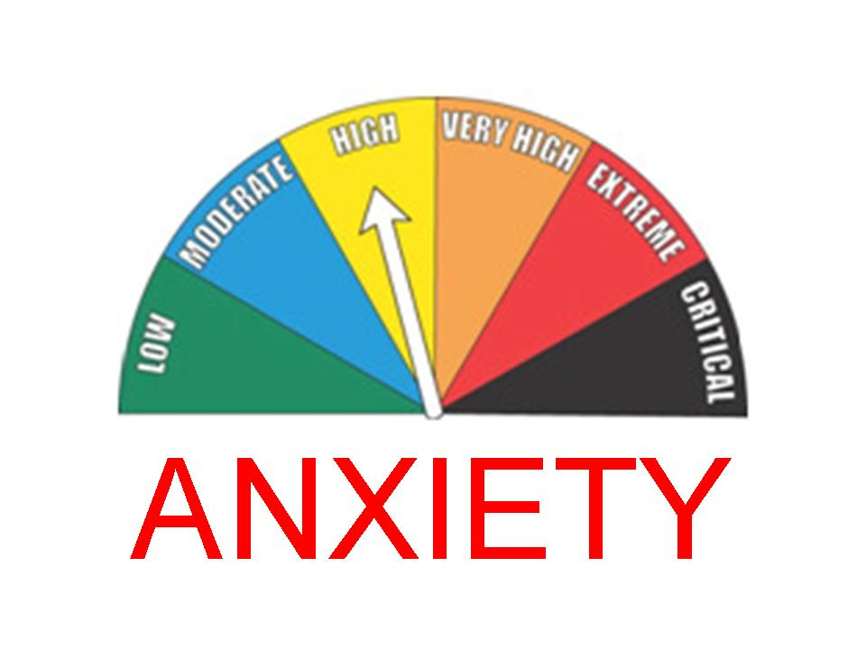
TYPES OF MOOD DISORDERS
Notes:
Anxiety
Anxiety disorder differs from normal stress and anxiety. The symptoms of an anxiety disorder are more severe and can cause impairment in daily life (i.e.. Work, relationships, daily activities - OIL)

Slide 10
U.S. ADULTS WITH AN ANXIETY DISORDER
IN ANY GIVEN YEAR
Type of Anxiety Disorder | % Adults
Specific phobia | 8.7
Social Anxiety Disorder | 6.8
Post–traumatic stress disorder | 3.5
Generalized anxiety disorder | 3.1
Panic disorder | 2.7
Obsessive–compulsive disorder | 1.0
Agoraphobia (without panic) | 0.9
Any anxiety disorder | 18.1
U.S. ADULTS WITH ANXIETY

Slide 11
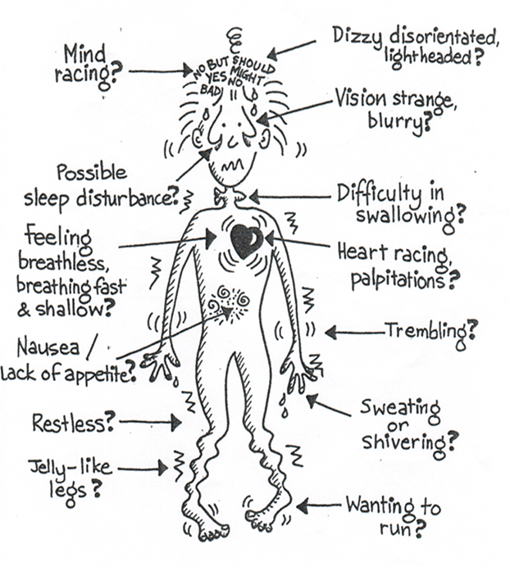
ANXIETY
Shaky Man is taken from the book by Bev Aisbett (1993) “Living with IT: A Survivor’s Guide to Panic Attacks”
Notes:
Anxiety disorders are the most common mental health concern in the United States. An estimated 40 million adults in the U.S. (18%) have an anxiety disorder. Meanwhile, approximately 8% of children and teenagers experience an anxiety disorder. Most people develop symptoms before age 21.
Panic Syndrome which affects around 5% of the population.
In 1993, after recovery from severe anxiety and depression, Bev turned to her artistic talents to create the first of her ground-breaking illustrated self-help books Living with IT- A Survivor's Guide to Panic Attacks. IT = The Anxiety Monster.

Slide 12
Anxiety: Signs and Symptoms
Physical
Cardiovascular: pounding heart, chest pain, rapid heartbeat, blushing
Respiratory: fast breathing, shortness of breath
Neurological: dizziness, headache, sweating, tingling, numbness
Gastrointestinal: choking, dry mouth, stomach pains, nausea, vomiting, diarrhea
Musculoskeletal: muscle aches and pains (especially neck, shoulders and back), restlessness, tremors and shaking, inability to relax

Slide 13
Anxiety: Signs and Symptoms
Behavioral
Avoidance of situations, obsessive or compulsive behavior, distress in social situations, phobic behavior
Psychological
Unrealistic or excessive fear and worry (about past and future events), mind racing or going blank, decreased concentration and memory, indecisiveness, irritability, impatience, anger, confusion, restlessness or feeling “on edge” or nervous, fatigue, sleep disturbance, vivid dreams

Slide 14
Video: National Anxiety Screening Project
Notes:
Watch Video on Anxiety writing down the physical, behavioral, and psychological s/s observed.

Slide 15
Risk Factors for Depression & Anxiety
Distressing and uncontrollable event
Stressful or traumatic events
Difficult childhood; history of childhood anxiety
Ongoing stress and anxiety
Another mental illness
Previous episode of depression or anxiety
Family history
More sensitive emotional nature

Slide 16
Risk Factors for Depression & Anxiety
Illness that is life threatening, chronic or associated with pain
Medical conditions
Side effects of medication
Recent childbirth
Premenstrual changes in hormone levels
Lack of exposure to bright light in winter
Chemical (neurotransmitter) imbalance
Substance misuse; intoxication, withdrawal

Slide 17
The Action Plan - ALGEE
Assess for risk of suicide or harm
Listen nonjudgmentally
Give reassurance and information
Encourage appropriate professional help
Encourage self-help and other support strategies
THE ACTION PLAN

Slide 18
Why Address Suicide Prevention
Over 800,000 ED visits for self-inflicted injuries annually (CDC, 2011 ).
Two thirds of people with a recent attempt (12 mos), visited an ED for any reason in the past year (Han, 2014).
44% of ED patients with suicidal ideation had a previous suicide attempt (Allen, 2013).
22% of people who died by suicide visited an ED in the 4 weeks prior to their death (Ahmedani, 2014).
The risk of a suicide attempt or death is highest within the first 30 days after discharge from an ED or inpatient psych unit; Yet up to 70% of patients who leave the ED after a suicide attempt never attend their first outpatient appointment (Knesper, 2010).
THE ACTION PLAN: “A”
Notes:
Source - 1 National Hospital Ambulatory Medical Care Survey
Why Address Suicide Prevention
The suicide rate among our ED patients is higher than population-based estimates, and rates of suicide completion among our ED patients with suicidal ideation, overdose, or self-harm are especially high. These findings support our ED policy that mandates psychiatric evaluation of all patients presenting with these conditions. The utility of these clinical characteristics in predicting later death from suicide, however, is limited, because the majority of our ED patients who later died from suicide did not have self-harm, suicide, or overdose noted in their electronic records.
https://pdfs.semanticscholar.org/3ccb/04520edf43e1053bf9d9728523f140c5c395.pdf
The risk of a suicide attempt or death is highest within 30 days of discharge from an ED or inpatient psychiatric unit.¹
Up to 70 percent of patients who leave the ED after a suicide attempt never attend their first outpatient appointment.¹
Approximately 37% of individuals without a mental health or chemical dependency diagnosis who died by suicide make an ED visit within a year of their death.²
https://www.sprc.org/settings/emergency-departments
The Suicide Prevention Resource Center (SPRC)
According to the Centers for Disease Control and Prevention, suicide is the tenth leading cause of death in the U.S., and research shows a substantial percentage of people who die by suicide present for healthcare in the year before their deaths. Screening for suicidality is a critical nursing function in the ED and provides healthcare professionals an opportunity to identify patients at risk for suicide and intervene appropriately.
Current literature reports that approximately 12.5 percent of ED visits are for behavioral health problems making it a common presentation. Only 3 percent of emergency patients will disclose suicidal thoughts, but studies show up to 12 percent have some suicidal ideation.
https://www.ena.org/press-room/2018/02/22/study-in-depth-emergency-department-suicide-screenings-should-become-common-practice

Slide 19
Warning Signs of Suicide
Threatening to hurt or kill oneself
Seeking access to means
Talking, writing, or posting on social media about death, dying, or suicide
Feeling hopeless
Feeling worthless or a lack of purpose
Acting recklessly or engaging in risky activities
Feeling trapped
Increasing alcohol or drug use
Withdrawing from family, friends, or society
Demonstrating rage and anger or seeking revenge
Appearing agitated
Having a dramatic change in mood
THE ACTION PLAN: “A”

Slide 20
Suicide Risk Assessment
Gender
Age
Chronic physical illness
Mental illness
Use of alcohol or other substances
Less social support
Previous attempt
Organized plan
THE ACTION PLAN: “A”

Slide 21
How to Talk with a Person Who Is Suicidal
Let the person know you are concerned and willing to help
Discuss your observations with the person
Ask the question(s) without dread
Do not express a negative judgment
Appear confident, as this can be reassuring
Check For Two Other Risks:
Has the person been using alcohol or other drugs?
Has he or she made a suicide attempt in the past?
THE ACTION PLAN: “A”
Notes:
Last 2 bullets – Check For Two Other Risks:
Previous behavior is the best predictor of future behavior

Slide 22
How to Talk with a Person Who Is Suicidal
Strategies for having a difficult or very personal conversation
Stepping aside from the computer, making eye contact.
Tell people what you are doing
Not What is said but How it is said
Ease into the conversation
Normalize the process
Open, honest, and direct.
Private area
THE ACTION PLAN: “A”
Notes:
How do you ask questions?
Tell people what you are doing - Introduction Segway – we ask these questions of everyone, it is important that you let us know what you are feeling and thinking so that we may help you, it’s not unusual for people to have these types of signs or symptoms.
Stepping aside from the computer, making eye contact. – Remove the barriers, physical, psychological –
be WITH people versus doing FOR people. Make a connection.
Number of males that seek treatment with PCP with depression – physical
What tool are being used? What triggers the use of the tool? PHQ-2 or PHQ-9?
In 2015, 505,507 people visited a hospital for injuries due to self-harm. This number suggests that for every reported suicide death, approximately 11.4 people visit a hospital for self-harm related injuries. However, because of the way these data are collected, we are not able to distinguish intentional suicide attempts from non-intentional self-harm behaviors. American Foundation for Suicide Prevention
The suicide rate among our ED patients is higher than population-based estimates, and rates of suicide completion among our ED patients with suicidal ideation, overdose, or self-harm are especially high. These findings support our ED policy that mandates psychiatric evaluation of all patients presenting with these conditions. The utility of these clinical characteristics in predicting later death from suicide, however, is limited, because the majority of our ED patients who later died from suicide did not have self-harm, suicide, or overdose noted in their electronic records.
https://pdfs.semanticscholar.org/3ccb/04520edf43e1053bf9d9728523f140c5c395.pdf

Slide 23
Columbia-Suicide Severity Rating Scale (C-SSRS)
Have you wished you were dead or wished you could go to sleep and not wake up?
Have you actually had any thoughts of killing yourself?
THE ACTION PLAN: “A”

Slide 24
Columbia-Suicide Severity Rating Scale (C-SSRS)
Have you been thinking about how you might do this?
Have you had these thoughts and had some intention of acting on them?
Have you started to work out or worked out the details of how to kill yourself? Do you intend to carry out this plan?
THE ACTION PLAN: “A”
Notes:
https://cssrs.columbia.edu
The Columbia-Suicide Severity Rating Scale (C-SSRS), the most evidence-supported tool of its kind, is a simple series of questions ...
Ask questions 1 and 2. If both are negative, continue to with your assessment or action plan. If the answer to question 2 is “yes”, ask questions 3, 4 and 5.
Have you wished you were dead or wished you could go to sleep and not wake up?
Have you actually had any thoughts of killing yourself?
Have you been thinking about how you might do this?
Have you had these thoughts and had some intention of acting on them?
Have you started to work out or worked out the details of how to kill yourself? Do you intend to carry out this plan?
Ask directly whether the person is suicidal:
“Are you having thoughts of suicide?”
“Are you thinking about killing yourself?”
If “yes “ to either above, then…
Ask whether the person has a plan:
“Have you decided how you are going to kill yourself?”
“Have you decided when you would do it?”
“Have you collected the things you need to carry out your plan?”

Slide 25
Keeping the Person Safe
Provide a safety contact number
Help the person identify past supports
Involve them in decision making
Call a CIT law enforcement immediately if the person is actively endangering the lives of self or others.
THE ACTION PLAN: “A”

Slide 26
Keeping the Person Safe
THE ACTION PLAN: “A”
Notes:
Crisis Intervention Training brochure

Slide 27
Keeping the Person Safe
Do Not
Leave an actively suicidal person alone
Use guilt and threats to try to prevent suicide
“You will go to hell”
“You will ruin other people’s lives if you die by suicide”
Agree to keep their plan a secret
THE ACTION PLAN: “A”

Slide 28
Reasons for Self-Injury
To escape unbearable anguish
To change the behavior of others
To escape a situation
To show desperation to others
To “get back at” other people
To gain relief from tension
To seek help
THE ACTION PLAN: “A”

Slide 29
How to Help with a Person Who Self-Injures
Recognize that self-injury is usually a symptom of serious psychological distress
Avoid any negative reactions to the self-injury
Discuss the situation calmly
Focus on ways to stop the distress
THE ACTION PLAN: “A”
Notes:
Routine care and you notice something.
How did this happen? Connect to ALGEE
In 2015, 505,507 people visited a hospital for injuries due to self-harm. This number suggests that for every reported suicide death, approximately 11.4 people visit a hospital for self-harm related injuries. However, because of the way these data are collected, we are not able to distinguish intentional suicide attempts from non-intentional self-harm behaviors. American Foundation for Suicide Prevention

Slide 30
How to Help with a Person Who Self-Injures
Do Not:
Focus on stopping self-injury
Trivialize the feelings or situations that have led to self-injury
Punish the person
Threaten to withdraw care
THE ACTION PLAN: “A”
Notes:
Anxiety (activity – true false of anxiety, suicide, and self-harming)

Slide 31
Listening Nonjudgmentally
Key attitudes to make the person feel respected, accepted, and understood:
Acceptance
Genuineness
Empathy
THE ACTION PLAN: “L”
https://youtu.be/1Evwgu369Jw?list=PLMG0jm_gg_UUZ8dMAq0a9w0HmSeDwiTXF
Notes:
Key attitudes to make the person feel respected, accepted, and understood:
Acceptance
Genuineness
Empathy
Key nonverbal skills to show you are actively listening:
Attentiveness
Comfortable eye contact
Open body posture
Being seated
Sitting next to the person rather than directly opposite
Do not fidget

Slide 32
THE ACTION PLAN: “G”

Slide 33
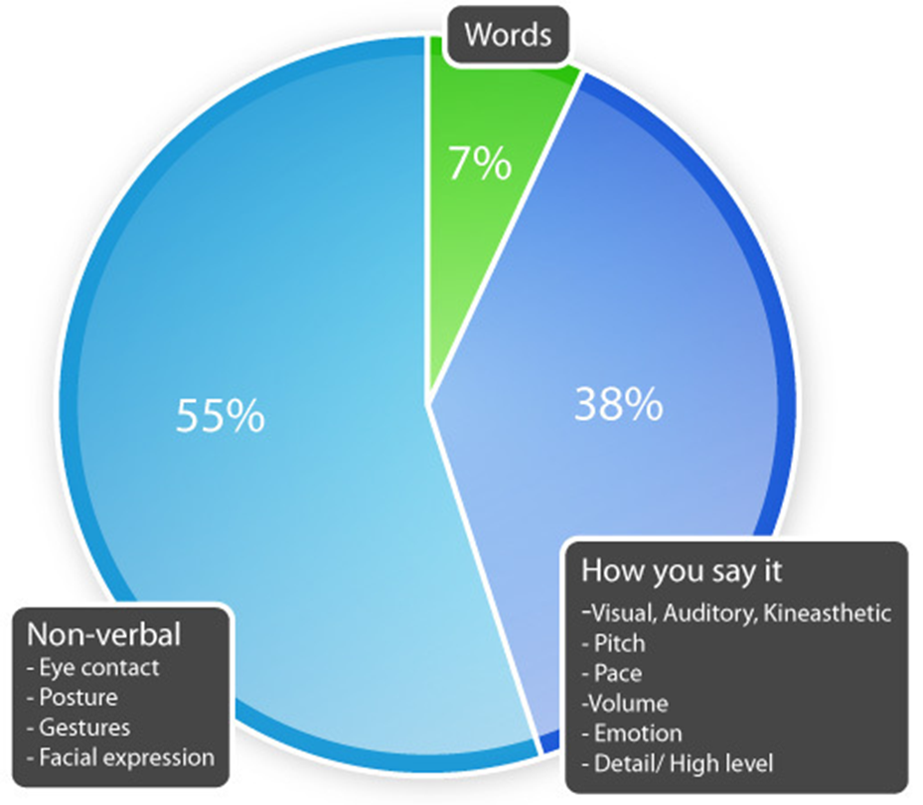
Listening Nonjudgmentally
THE ACTION PLAN: “L”
Notes:
Key attitudes to make the person feel respected, accepted, and understood:
Acceptance
Genuineness
Empathy
Key nonverbal skills to show you are actively listening:
Attentiveness
Comfortable eye contact
Open body posture
Being seated
Sitting next to the person rather than directly opposite
Do not fidget
Not so much what is said versus how it’s said. What did I say?
80% -- 90% of our communication is non-verbal. It is very important to be able to identify exactly what we are communicating to others non-verbally.
You may be trying to de-escalate the situation by talking to the other person, but your body language may be showing a willingness to get physical.
It is also important that we recognize and understand the non-verbal cues from another person who has the potential of escalating.

Slide 34
Give Reassurance and Information
Treat the person with respect and dignity
Understand that symptoms are an expression of distress or part of an illness
Have realistic expectations
Offer consistent emotional support and understanding
Give the person hope for recovery
Provide practical help
Offer credible information
THE ACTION PLAN: “G”
THE ACTION PLAN: “G”

Slide 35
What Isn’t Supportive Do Not:
Tell the person to “snap out of it”
Act hostile or sarcastic
Blame person for symptoms
Adopt an overinvolved or overprotective attitude
Nag the person to do what he or she normally would do
Trivialize the person’s experiences
Belittle or dismiss the person’s feelings
Speak with a patronizing tone
Try to “cure” the person
THE ACTION PLAN: “G”

Slide 36
Encourage Appropriate Professional Help
Types of Professionals
Doctors (primary care physicians)
Psychiatrists
Social workers, counselors, and other mental health professionals
Certified peer specialists
Types of Professional Help
“Talk” therapies
Medication
Other professional supports
THE ACTION PLAN: “E”
Notes:
You need to know the plan for your setting.
Zero suicide website – great guides and tools. Tools for their organization to address culture, protocol,
We need to ensure everyone is ready, individuals and companies and hospital is ready.
BH in the clinical setting – already among professional but connecting to outside professionals.
Mobile Crisis team – PCP, specialty clinic, move to ED, 911. Call Alliance – Access and Information Center.

Slide 37
Help & Information available 24/7 every day
800-510-9132
Notes:
Call the Behavioral Health Eexpert
HELP & INFORMATION AVAILABLE 24/7 EVERY DAY: 800-510-9132
Promoting recovery in Cumberland, Durham, Johnston and Wake Counties
Pass out the Alliance Crisis Cards, business cards, and/or brochures.

Slide 38
Encourage Self-Help and Other Support Strategies
Exercise
Relaxation and Meditation
Peer support groups
Self-help books based on cognitive behavioral therapy (CBT)
Family, friends, faith, and other social networks
THE ACTION PLAN: “E”
Notes:
NAMI

Slide 39
For more information, please contact:
James Osborn, LPA, LCAS
Director of Community Education and Outreach
(919) 651-8440
josborn@AllianceBHC.org

