Slide 1
Behavioral Health
Psychosis
Substance Use Disorder
Serving Durham, Wake, Cumberland and Johnston Counties

Slide 2
Notes:
What is Psychosis?
Psychosis is a condition in which a person has lost some contact with reality
The person may have severe disturbances in thinking, emotion, and behavior
Disorders in which psychosis can occur are not as common as depression and anxiety disorders
Psychosis usually occurs in episodes and is not a constant or static condition
a severe mental disorder in which thought and emotions are so impaired that contact is lost with external reality.

Slide 3
Common Symptoms When Psychosis is Developing
Changes in emotion and motivation
Depression
Anxiety
Irritability
Suspiciousness
Blunted, flat, or inappropriate emotion
Change in appetite
Reduced energy and motivation
Notes:
Feelings
Sad or irritable
Isolated
Confused or Puzzled
Like you cannot trust people
Like you are being watched.

Slide 4
Common Symptoms When Psychosis is Developing
Changes in thinking and perception
Difficulties with concentration or attention
Sense of alteration of self, others, or the outside world (e.g., feeling that self or others have changed or are acting different in some way)
Odd ideas
Unusual perceptual experiences (e.g., a reduction in or greater intensity of smell, sound, or color)
PSYCHOSIS
Notes:
Thinking and Perception
Thinking that people are against you or talking about you
Receiving personal messages from the TV or radio
Senses seems sharper
Hearing voices
Seeing visions or things that others cannot see
Thinking that you have special powers

Slide 5
Common Symptoms When Psychosis is Developing
Changes in behavior
Sleep and appetite disturbances
Social isolation or withdrawal
Reduced ability to carry out work and social roles
PSYCHOSIS
Notes:
Behavior
Talking or smiling to yourself
Neglecting your appearances
Avoiding contact with people

Slide 6
Notes:
Change Direction .org
Purpose
The Change Direction initiative is a collection of concerned citizens, nonprofit leaders, and leaders from the private sector who have come together to change the culture in America about mental health, mental illness, and wellness. This initiative was inspired by the discussion at the White House National Conference on Mental Health in 2013, which came on the heels of the Newtown, Conn. tragedy.
By bringing together this unprecedented and diverse group of leaders we plan to spark a movement that:
frees us to see our mental health as having equal value to our physical health
creates a common language that allows us to recognize the signs of emotional suffering in ourselves and others
encourages us to care for our mental well-being and the mental well-being of others

Slide 7
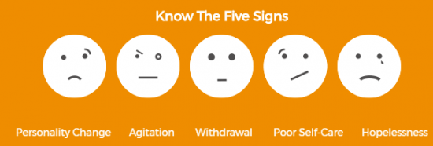

Slide 10
Types of Disorders in Which Psychosis May Occur
Schizophrenia
Bipolar disorder
Psychotic depression
Schizoaffective disorder
Drug-induced psychosis

Slide 11
Symptoms of Schizophrenia
Delusions
Hallucinations
Disorganized speech
Disorganized behavior
Loss of drive
Blunted emotions
Social withdrawal

Slide 12
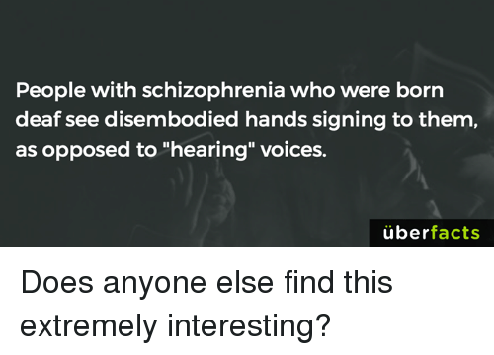
Notes:
Activity: Auditory-Hallucination-Script

Slide 13
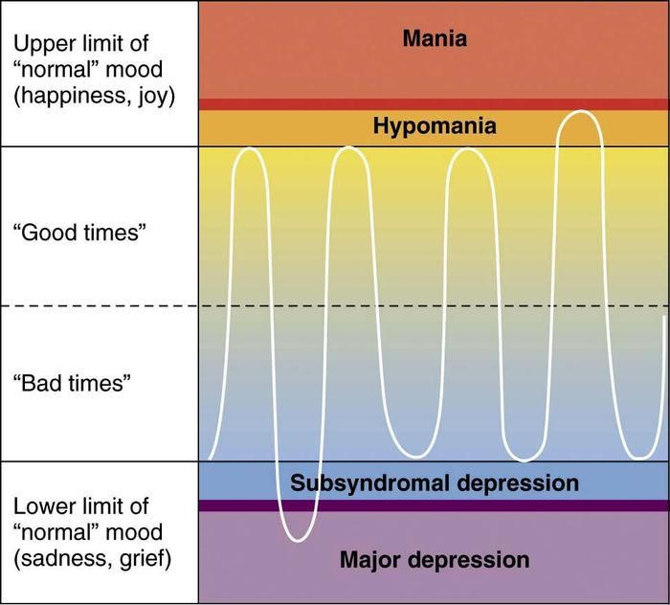
Notes:
Symptoms of Manic Episode (Bipolar)
Feeling unusually “high” and optimistic or extremely irritable
Unrealistic, grandiose beliefs about one’s abilities, increase in goal directed behavior
Increased energy and overactivity
Decreased need for sleep and still feeling energetic
Racing thinking and rapid speech
Distractibility
Excessive pleasurable activities
Impaired judgement, impulsiveness and lack of insight

Slide 14
Without Early Intervention
Poorer long-term functioning
Increased risk of depression and suicide
Increased use of alcohol and drugs
Slower psychological maturation and delay in assuming adult responsibilities
Strain on relationships and subsequent loss of social supports
Disruption of education and employment
Loss of self-esteem and confidence
Greater chance of problems with the law
EARLY INTERVENTION

Slide 15
The Action Plan - ALGEE
Assess for risk of suicide or harm
Listen nonjudgmentally
Give reassurance and information
Encourage appropriate professional help
Encourage self-help and other support strategies
THE ACTION PLAN
Notes:
Show the Psychosis Video

Slide 16
What are Substance Use Disorders?
SUBTANCE USE DISORDERS
Dependence
Abuse that leads to problems at home or work
Abuse that causes damage to health
Notes:
What are Substance Use Disorders?
Dependence – Severe SUDs include signs/symptoms - s/s of tolerance and withdrawal.
Use that leads to problems at home or work
Use that causes damage to health

Slide 17
Understanding Substance Use Disorders
8.1% of the population over 12 have a substance use disorder in any given year
The use of alcohol or drugs does not mean a person has a substance use disorder
75% of people who develop substance use disorders do so by age 27
Alcohol use disorders are almost three times as common as drug use disorders
SUBSTANCE USE DISORDERS

Slide 18
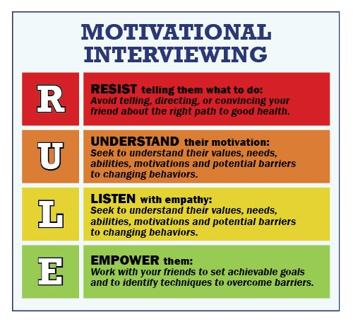
SUBSTANCE USE DISORDERS
https://www.centerforebp.case.edu/client-files/pdf/miremindercard.pdf
Notes:
Motivational Interview card – website. https://www.centerforebp.case.edu/ - Center for Evidenced Based Practices
Motivational interviewing is a psychotherapeutic approach that attempts to move an individual away from a state of indecision or uncertainty and towards finding motivation to making positive decisions and accomplishing established goals.
Express and Show Empathy Toward Clients.
Support and Develop Discrepancy.
Deal with Resistance.
Support Self-Efficacy.
Autonomy.
http://work.chron.com/5-principles-motivational-interviewing-1836.html
Questions about Psychosis and SUDS using Motivational Interview?
Questions to ask and questions to not ask
WAIT – Why Am I Talking
Truly listening is not waiting for my turn to talk

Slide 19
Motivational Interviewing - Am I Doing this Right?
Do I listen more than I talk?
Or am I talking more than I listen?
Do I keep myself sensitive and open to this person’s issues, whatever they may be?
Or am I talking about what I think the problem is?
Do I invite this person to talk about and explore his/her own ideas for change?
Or am I jumping to conclusions and possible solutions?
SUBSTANCE USE DISORDERS
Notes:
Go Round Robin through the audience asking each person to read one question – Positive in black then negative.
Motivational Interview card – website. https://www.centerforebp.case.edu/ - Center for Evidenced Based Practices
Motivational interviewing is a psychotherapeutic approach that attempts to move an individual away from a state of indecision or uncertainty and towards finding motivation to making positive decisions and accomplishing established goals.
Express and Show Empathy Toward Clients.
Support and Develop Discrepancy.
Deal with Resistance.
Support Self-Efficacy.
Autonomy.
http://work.chron.com/5-principles-motivational-interviewing-1836.html
Questions about Psychosis and SUDS using Motivational Interview?
Questions to ask and questions to not ask
WAIT – Why Am I Talking
Truly listening is not waiting for my turn to talk

Slide 20
Motivational Interviewing - Am I Doing this Right?
Do I encourage this person to talk about his/her reasons for not changing?
Or am I forcing him/her to talk only about change?
Do I ask permission to give my feedback?
Or am I presuming that my ideas are what he/she really needs to hear?
Do I reassure this person that ambivalence to change is normal?
Or am I telling him/her to take action and push ahead for a solution?
SUBSTANCE USE DISORDERS
Notes:
Motivational Interview card – website. https://www.centerforebp.case.edu/ - Center for Evidenced Based Practices
Motivational interviewing is a psychotherapeutic approach that attempts to move an individual away from a state of indecision or uncertainty and towards finding motivation to making positive decisions and accomplishing established goals.
Express and Show Empathy Toward Clients.
Support and Develop Discrepancy.
Deal with Resistance.
Support Self-Efficacy.
Autonomy.
http://work.chron.com/5-principles-motivational-interviewing-1836.html
Questions about Psychosis and SUDS using Motivational Interview?
Questions to ask and questions to not ask
WAIT – Why Am I Talking
Truly listening is not waiting for my turn to talk

Slide 21
Motivational Interviewing - Am I Doing this Right?
Do I help this person identify successes and challenges from his/her past and relate them to present change efforts?
Or am I encouraging him/her to ignore or get stuck on old stories?
Do I seek to understand this person?
Or am I spending a lot of time trying to convince him/her to understand me and my ideas?
Do I summarize for this person what I am hearing?
Or am I just summarizing what I think?
SUBSTANCE USE DISORDERS
Notes:
Motivational Interview card – website. https://www.centerforebp.case.edu/ - Center for Evidenced Based Practices
Motivational interviewing is a psychotherapeutic approach that attempts to move an individual away from a state of indecision or uncertainty and towards finding motivation to making positive decisions and accomplishing established goals.
Express and Show Empathy Toward Clients.
Support and Develop Discrepancy.
Deal with Resistance.
Support Self-Efficacy.
Autonomy.
http://work.chron.com/5-principles-motivational-interviewing-1836.html
Questions about Psychosis and SUDS using Motivational Interview?
Questions to ask and questions to not ask
WAIT – Why Am I Talking
Truly listening is not waiting for my turn to talk

Slide 22
Motivational Interviewing - Am I Doing this Right?
Do I value this person’s opinion more than my own?
Or am I giving more value to my viewpoint?
Do I remind myself that this person is capable of making his/her own choices?
Or am I assuming that he/she is not capable of making good choices?
SUBSTANCE USE DISORDERS
Notes:
Motivational Interview card – website. https://www.centerforebp.case.edu/ - Center for Evidenced Based Practices
Motivational interviewing is a psychotherapeutic approach that attempts to move an individual away from a state of indecision or uncertainty and towards finding motivation to making positive decisions and accomplishing established goals.
Express and Show Empathy Toward Clients.
Support and Develop Discrepancy.
Deal with Resistance.
Support Self-Efficacy.
Autonomy.
http://work.chron.com/5-principles-motivational-interviewing-1836.html
Questions about Psychosis and SUDS using Motivational Interview?
Questions to ask and questions to not ask
WAIT – Why Am I Talking
Truly listening is not waiting for my turn to talk

Slide 23
SUBSTANCE USE DISORDERS
Notes:
CAGE
How to ask questions about SUDS? Minimize or exaggerate use.
Individuals may answer a question – faking good or bad – based upon what they are attempting to get or avoid. Everyone is attempting to get their needs met. It may be done in a positive/healthy or negative/unhealthy strategy.

Slide 24
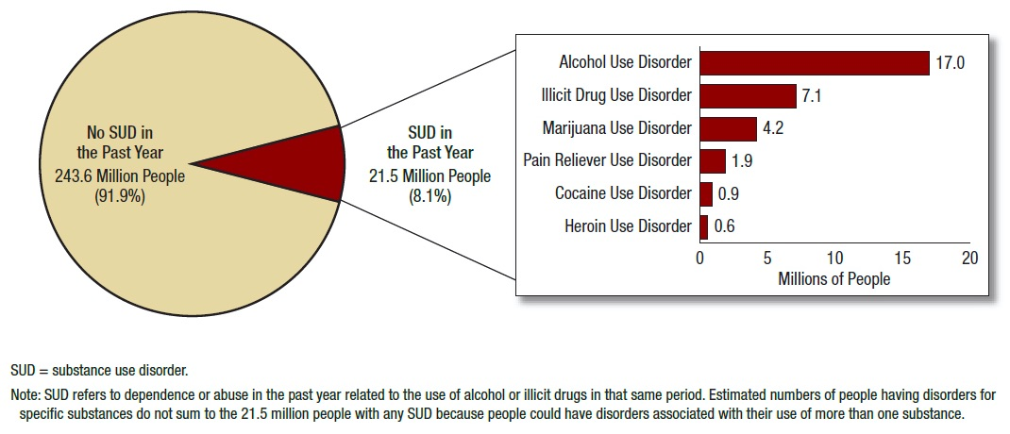
Substance Use Disorders in the US - 2014
Notes:
Center for Behavioral Health Statistics and Quality. (2015). Behavioral health trends in the United States: Results from the 2014
National Survey on Drug Use and Health (HHS Publication No. SMA 15-4927, NSDUH Series H-50).http://www.samhsa.gov/data/sites/default/files/NSDUH-FRR1-2014/NSDUH-FRR1-2014.htm#idtextanchor086 accessed January 04, 2016.

Slide 25
Notes:
Activity: Who Am I?

Slide 26
Risk Factors for Substance Use Disorders
Availability and tolerance of the substance in society
Social factors
Genetic predisposition
Sensitivity to the substance
Learning/Exposure
Other mental health problems

Slide 27
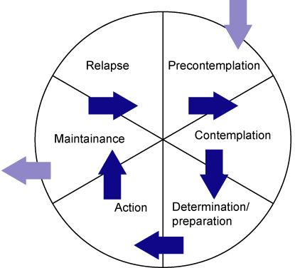
The Stages of Change
Stages of Change Model (Prochaska and DiClemente)
Notes:
Empathy
Weight, diet, exercise
Major life changes.
These are the 5 stages of motivational interviewing – 80% of people seek treatment in stage 1-3. Really there are 6 stages including Relapse.
The stages of change are:
Precontemplation (Not yet acknowledging that there is a problem behavior that needs to be changed)
Contemplation (Acknowledging that there is a problem but not yet ready or sure of wanting to make a change)
Preparation/Determination (Getting ready to change)
Action/Willpower (Changing behavior)
Maintenance (Maintaining the behavior change) and
Relapse (Returning to older behaviors and abandoning the new changes) or Termination – former behavior no longer seen as desirable.

Slide 28
Encourage Self-Help and Other Support Strategies
Support groups
Family, friends, and faith networks
Avoidance of friends and social settings involving alcohol and other drugs
Self-help groups
As of 2015, Alcoholics Anonymous (AA) had more than 115,000 groups worldwide and 60,000 groups and 1.2 million members in the United States.
As of 2015, Narcotics Anonymous (NA) had more than 63,000 meetings weekly in 132 countries.
Notes:
Treatment Gap: In 2014, an estimated 22.5 million Americans aged 12 or older needed treatment for a problem related to drugs or alcohol, but only about 4.1 million people received treatment.

Slide 29
WHY MENTAL HEALTH FIRST AID?
Notes:
Pass out the Activity: Booze Q? Quiz – 10 minutes – use Kahoot

Slide 30
For more information, please contact:
James Osborn, LPA, LCAS
Director of Community Education and Outreach
(919) 651-8440
josborn@AllianceBHC.org
Notes:
Panel discussion – LaTonya will share experience with her son accessing services. She felt judged.
Person under the behavior – don’t judge the book by the cover. Listen nonjudgementally -

