Slide 1
Processes and Partnership with Nursing on Mitigating Drug Diversion in Clinical Settings
Jesse Breidenbach, Pharm D
Director of Acute Care Pharmacy
Sanford Medical Center Fargo

Slide 2
Objectives
Define successful structure to prevent drug diversion in a clinical setting
  Define how tight control of narcotics in a clinical setting protects against diversion
  Organized plan for diversion investigation
  Develop a team approach for diversion investigation
  Describe staff and leadership education
Describe common reasons supervisors are surprised that an employee is diverting drugs
  Define the top myths of behavior
  Describe how supervisors should use a team approach to prevent blind spots

Slide 3
What is Drug Diversion?
The theft of a controlled substance or other medications from the organization’s supply, or from a patient’s supply, for purposes of self-administration, selling or other use.

Slide 4

Prevalence in Healthcare
It’s estimated that:
Greater than 100,000 healthcare workers (Doctors, Nurses, Medical Technician, Healthcare Aides, etc) are abusing or dependent on prescription drugs in a given year
(USA Today report released in April 2014)
1 in 10 physicians develop problems with alcohol or drugs at some point during their careers
(Patrick Skerret, Director Harvard Health)
10-15% of all nurses may be impaired or in recovery from addiction

Slide 5
Impact on the Workplace
Patient Care & Safety
Patient Satisfaction
Lost Productivity
Poor Decision Making
Safety Risk
Decreased Morale
Bottom Line

Slide 6
Prevention of drug diversion in a clinical setting
DEA requirements
  DEA form 106
  “Federal regulations require that registrants notify the DEA Field Division Office in their area, in writing, of the theft or significant loss of any controlled substance within one business day of discovery of such loss or theft. The registrant shall also complete and submit to the Field Division Office in their area, DEA Form 106, "Report of Theft or Loss of Controlled Substances" regarding the theft or loss. (21 C.F.R. § 1301.76(b))”
  https://www.deadiversion.usdoj.gov/21cfr_reports/theft/
Notes:
Any theft is required to be reported, loss needs meet a significant threshold to be reported (somewhat subjective)

Slide 7
Prevention of drug diversion in a clinical setting
Defined process for ordering, receiving, restocking and dispensing controlled substances (CS)
  Limited access to ordering
    CSOS/DEA 222 forms
  Receiving
    Person placing CS order does not receive/check in CS order
    CS stored in narcotic vault in pharmacy
  Restocking
    Narcotic vault communicates with automated dispensing cabinets
    CS removed from vault for restocking creates an open loop
      Loop is closed when the cabinet has that narcotic restocked
      Loops can be closed manually but not by the person that opened the loop (monitored)
  Dispensing CS
    Primarily via automated dispensing cabinets
      Enables extensive tracking and documentation of access
    Non-automated dispenses
      Maintain chain of custody

Slide 8
Prevention of drug diversion in a clinical setting
Tight control of controlled substances is necessary to prevent diversion
  Documentation of what was done with the CS
  Security – locked or under constant supervision
  ADCs often used for most frequently used
Enforced by policy and auditing to policy requirements
  Auditing can be very time consuming
  Policies need to support best practices and be enforced
Decision support/data review
  Identify potential diverters

Slide 9
Prevention of drug diversion in a clinical setting
Nursing CS workflow
  Order for CS received, verified and on patient MAR
  Nurse obtains CS for administration
    CS typically dispensed from automated dispensing cabinet (ADC)
    If dose = full vial/syringe
      Nurse removes CS from ADC
      Nurse administers CS via barcode med administration (BCMA) on MAR
    If dose = partial vial/syringe (best practice – waste before administration)
      Nurse finds witness
      CS removed from ADC with witness
      Nurse draws up dose with witness
      Nurse wastes portion of CS not needed with witness (documents waste in ADC prior to administration)
      Nurse administers dose via BCMA
      CS should be fully accounted for (waste, and administration should = what was removed)

Slide 10
Prevention of drug diversion in a clinical setting
Nursing CS workflow (continued)
  Time constraints around administration
    CS must be administered within 30 minutes after obtaining/removing CS from ADC
    Documentation of waste is required to be completed within 30 minutes of administration
      If this does not happen concerns over where the CS is being stored
    If CS removed but not administered – a witnessed waste (opened product) or return (intact product) must happen within 30 minutes of the removal from the ADC
  Chain of custody
    Nurse removing CS from ADC or obtaining CS from pharmacy is responsible for what happens to the CS
    Nurse removing from CS should be administering nurse whenever possible
  ADC discrepancy resolution
    Charge nurses only (tightened this practice)
    Need to know what actually happened to cause the discrepancy not just clearing the discrepancy off of the cabinet
    If unable to determine what happened submit an event report

Slide 11
Prevention of drug diversion in a clinical setting
Best practice minimizes opportunity for diverting
Best practice allows the witness to verify drug and amount being wasted
  Best practice witness should see the vial opened or the syringe removed from it’s tamper evident packaging
Exceptions to best practice (a witness is not immediately available)
  A witnessed waste is expected to occur within 30 minutes of the administration
    In this case the witness can only confirm volume of waste not actual drug being wasted
  Procedural areas
    Documentation of all waste within 30 minutes of completion of the case

Slide 12
Prevention of drug diversion in a clinical setting
Pitfalls
Chain of custody
  Jenni, RN removes fentanyl from ADC for patient X to be administered by Mike, RN
  Jenni hands Mike the fentanyl and does not observe the administration of the CS
  CS audit reveals that not all fentanyl is accounted for and patient Xs clinical condition did not warrant fentanyl administration
  CS removal is tracked back to Jenni as she removed the fentanyl from the ADC
  Who is responsible for the fentanyl
    Only remove medications for patients assigned to you
    Do not hand off CS to other staff
Missing drug or missing documentation
  Audit reveals that 4mg of morphine removed for patient Y
  MAR audit reveals that 3mg of morphine documented as administered for pain score of 8
  No documentation for missing 1mg of morphine
  Is this missing drug or missing documentation?

Slide 13
Organized Plan for Diversion Investigations
Have sound institutional policy regarding drug diversion
  Input from nursing, pharmacy, legal, risk, providers and administration/HR
  Supports best practices
  Policy provides basis for corrective action
Use of a checklist that follows policy
  Help guide the investigation
  Keeps investigating team on the same page
  Difficult to navigate investigation if you have not been involved in one in the past
    Leadership turnover
Timing of the investigation and potential meeting with staff being investigated
  Call the staff person in on day off or wait until their next scheduled shift
What happens to the employee during this time
  limiting access to drugs/ADC access
  Cover staffing if you don’t plan to have them staff after meeting

Slide 14
Organized Plan for Diversion Investigations
Accurate data from a reliable source
  CS logs and chart information
    MAR administrations
    ADC dispensation, waste and return documentation
  ADC reporting and diversion scoring
    HBI data – third party data analysis
Observation of control/wasting practices
  Employee pledge
  Documented observation of best practices being followed
Work and communication performance
  Often discussed during investigating team meeting and/or with staff being investigated
When is it beneficial use of a Drug screen
  Pros and cons of drug screening related to diversion
    Diverting for self or possibly for others
    Easy to have diversion without an impaired professional

Slide 15
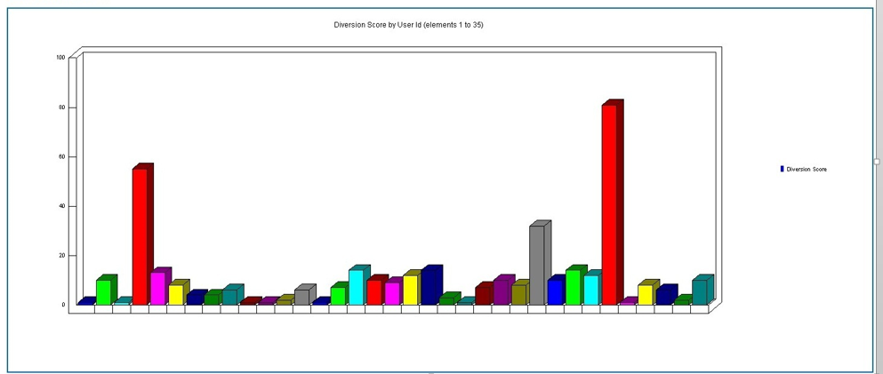
Audit
Potential Diverters Report Unit Drill Down

Slide 16
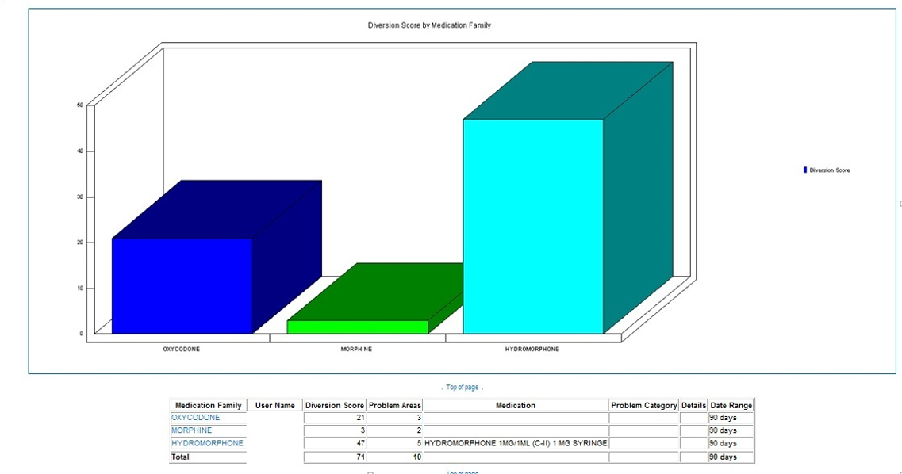
Audit
Potential Diverters Report Unit Drill Down

Slide 17
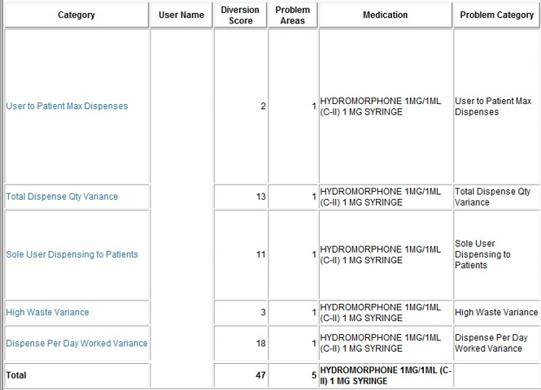
Audit
Potential Diverters Report Unit Drill Down

Slide 18
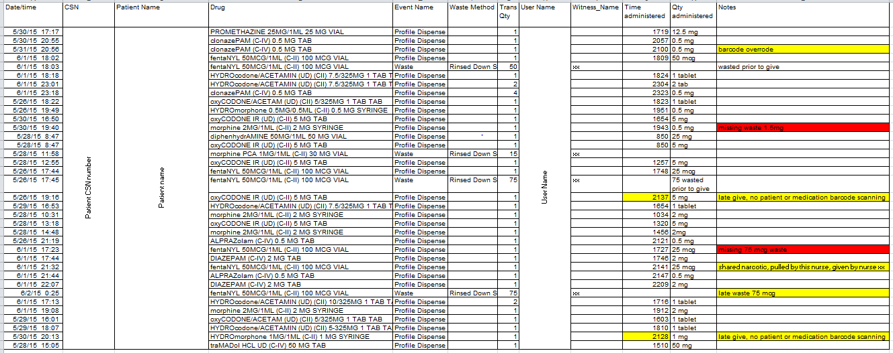
Audit

Slide 19
Diversion Checklist
Review:
Potential diversion identified by reports/audits, employee performance/behavior, positive reasonable suspicion results. Pharmacy notifies Manager and Director if a potential diverter is identified through audit.
Director/Manager contacts HR Director
Director/Manager organizes meeting to review and discuss findings
Determination made to meet with employee to share findings
HR and Manager organizes meeting with employee (logistics of place, time, etc., i.e. a room away from employee's work area, time is as soon as possible)
Notes:
Handout
Facilitation of Staff Interview
who will ask about what at the meeting
roles and the why
need to stay objective will be some debate
learning experience

Slide 20
Diversion Checklist
Review:
Manager calls employee to schedule a meeting as soon as possible. If working, removed from work area immediately (not allowed to work during interim of initial investigation meeting and meeting with the employee)
Director and Manager determine if suspension (with or without pay) is needed
Manager to meet employee and escort to meeting location. The purpose is to confront the employee with evidence regarding suspected diversion.
Employee Meeting to review suspected diversion
Termination (if applicable), Follow Up

Slide 21
Team Approach For Diversion Investigation
An educated/experienced core team is key
  It should have at the minimum Nursing Practice, HR, Pharmacy, Risk and a “like” provider if appropriate
The core team should be
  well versed in the reading /analyzing the data
  ability to ask hard questions
  seasoned leaders
  understand appropriate regulations
  be able to respond on a short notice to support the direct supervisors
    Needs to be a priority when diversion is suspected
The team develops an action plan with the direct supervisor and see that the plan is carried out
The team is a support system for the direct supervisor and is also responsible to see that the employee is fairly treated

Slide 22
Team Approach For Diversion Investigation
Set up Drug Diversion Mitigation Committee to meet on an on going basis:
  CMO, CNO, Risk, Office of Nursing Practice, Security Director, Legal, HR, Anesthesia, Pharmacy

Slide 23
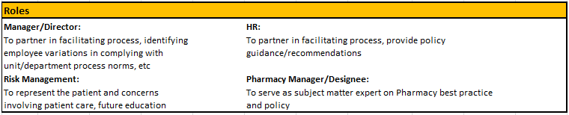
Diversion Checklist Roles
Created to assist as needed with potential diversion situations
Working document

Slide 24
Staff And Leadership Education
Leaders are often naïve about the consequences and prevalence of addiction issues
Both regulatory and policy need to be thoroughly discussed and review
Leaders need a structure to rely upon to be sure that all aspects are covered
  education on process flow or checklist approach is important
Leaders and staff needs to understand signs and symptoms of an impaired coworker
  Why some signs may actually fool you
  Staff need to know how to reach out and speak up about concerns
Staff need to have clear understanding/expectations
  competency assessed on a regular basis on CS policies and procedures

Slide 25
Staff And Leadership Education
All nursing staff educated
  All nurses validated on appropriate wasting and chain of custody for CS
All nursing management educated
  Supervisors through directors
  What is diversion
  Policy review
  Diversion team/checklist
  Identification of resources
Physician executive council educated
Anesthesia department educated

Slide 26
Leadership Expectation
Understand the issue from a Patient Safety Viewpoint
Use a balanced team to scope, analyze issues and agree on a plan forward
Be open to the fact that you might be blind sided
Be open to examining work flows that are preventing best practices and changing them

Slide 27
Common reasons for not identifying diversion
Top myths of staff diverting CS
A person with addiction is very smart, wants to work, and wants to stay in good standing
  These characteristics help keep them in proximity to drugs, because these behaviors keep the employee “under the radar” or “out of trouble”
These employees are often very “helpful”
  They offer to run and get things
  They offer to run to give meds to your patients
  They offer to run to pharmacy to pick up a drip
  These behaviors keep them valuable to their team members
  There is a less likely chance someone would report “odd” behavior when they like the person (the person is “being helpful”)

Slide 28

Why don’t we see it?
Award Winners
Techs, Providers, Nurses
New Grads
Pregnant Healthcare Workers
Pharmacists, Aides
Team Leaders
Notes:
This slide may be good for examples, recent concerns we’ve been through
Hindsight 20/20

Slide 29
Signs and Symptoms
Emotionally
  Aggression, anxiety, paranoia, defensive
Behaviorally
  Increased absence/availability to pick up shifts, unsteady, slurred speech, irritable, overly helpful i.e. “I’ll pull your meds for you”
Physically
  Weight loss, sweating, smell of alcohol, pinpoint pupils or glassy-eyed, lethargic
Notes:
Additional questions to consider:
What is the culture on my unit?
How well do my employees understand this?

Slide 30
How Supervisors Should Use A Team Approach To Prevent Blind Spots
Supervisors are invested in staff they hire
  They support and want to believe they made a good choice to hire the person
  They might develop personal relationships with staff (inside and outside of work)
Supervisors like being fully staffed
  Dealing with the issue may mean a gap in schedule
  Cases where diverting staff has been working a lot/picking up shifts
Because of these blinders, Supervisors need a team of objective and multi-disciplinary leaders to help drive the investigation and planning
These are hard conversation so having a team approach gives the directors and supervisors support in the actual meetings and interventions

Slide 31
Resources:
Road Map to Diversion Prevention: http://www.health.state.mn.us/patientsafety/drugdiversion/divroadmap041812.pdf
http://www.nursingworld.org/DocumentVault/Position-Statements/Drug-and-Alcohol-Abuse/pos.html
DEA Office of Diversion Control: https://www.deadiversion.usdoj.gov/index.html
NCSBN Substance Abuse Disorder in Nursing: https://www.ncsbn.org/index.htm
Substance Abuse and Mental Health Services Adminis-tration. (2010). Results from the 2009 National Survey on Drug Use and Health: Volume I. Summary of National Findings (Office of Applied Studies, NSDUH Series H-38A, HHS Publication No. SMA 10-4586 Findings). Rockville, MD.
Hansen RN, Oster G, Edelsberg J, Woody GE, Sullivan SD (2011). Economic costs of nonmedical use of prescription opioids. Clinical Journal of Pain 27(3): 194-202.

