Slide 1
North Carolina Health Association Economic Impact Analysis
| April 30, 2026

Slide 2
Table of Contents
Main Findings
Methodology
Hospital Composition and Workforce
Economic Contributions
References
Appendix A – Construction Impacts

Slide 3
North Carolina health systems and hospitals are an economic powerhouse:
In 2024, health systems and hospitals invested $44 billion in staff and operations—nearly half directed to salaries, benefits, and workforce compensation.
$1.8 billion poured into new healthcare facility construction, expanding access statewide.
Directly sustained 224,000 jobs—ranking among the top 10 employers in 95 of 100 counties and a top 3 employer in 49 counties (BLS, 2024).
Fueled an additional 240,000 jobs across real estate, management, food service, and more—bringing the total to 464,000 jobs, or 1 in 15 positions in the state.

Slide 4
North Carolina health systems and hospitals give back at scale:
Delivered over $8.24 billion in community benefits—from charity care and Medicare/Medicaid shortfalls to graduate medical education and donated services (HCRIS 2021–2024).
Contributed $2.8 billion in state and local taxes—funding K–12 schools, law enforcement, and essential social services across every region of the state.
Beyond taxes, hospitals pay annual state assessments—including $165 million each year directed to the state’s Medicaid General Fund—ensuring coverage for North Carolina’s most vulnerable residents.

Slide 5
Methodology

Slide 6
Methodology
RTI used IMPLAN, a leading U.S. input-output model, to trace how NCHA hospital spending generates wages, revenue, and jobs.
Data drawn from 2021–2024 CMS HCRIS covering operating expenditures, auxiliary employment, capital expenditures, and payroll.
  Operating expenses: Exclude salaries/benefits; modeled separately for public vs. private hospitals.
  Auxiliary facilities: Identified via Dun & Bradstreet data (physician offices, labs, home health, ambulatory care, nursing facilities).
    New to this analysis for improved accuracy.
  Capital expenditures: Six categories of equipment and construction investment, averaged across four years.
  Payroll: Wages, salaries, benefits, and contract labor. Gaps estimated via per-bed costs by location.

Slide 7
Hospital Composition and Workforce

Slide 8
Approximately 67% of all hospitals are in metropolitan counties, and 50% of hospitals have between 50 and 199 beds. The average number of beds per hospital is 175.
Number of Hospitals by County Designation and Number of Beds
Number of Beds | Nonmetropolitan | Micropolitan | Metropolitan | Total
0-49 | 9 | 2 | 25 | 36
50-199 | 9 | 19 | 39 | 67
200+ | 0 | 5 | 25 | 30
Total | 18 | 26 | 89 | 133
Source: RTI International based on information from HCRIS and the U.S. Census Bureau.
Hospitals in metropolitan and micropolitan counties tend to be larger, having an average of 197 and 184 beds, respectively, compared with an average of 58 beds for hospitals in nonmetropolitan counties.
Notes:
Metropolitan counties are defined by the U.S. Census Bureau as containing or adjacent to an urban area of at least 50,000 inhabitants. Micropolitan counties are those containing or adjacent to an urban area of at least 10,000 but less than 50,000 inhabitants. RTI designated counties not containing or adjacent to urban areas of the required population size as “nonmetropolitan” counties. A map of North Carolina county designations can be viewed here: https://www2.census.gov/programs-surveys/metro-micro/reference-maps/2020/state-maps/37_NorthCarolina_2020.pdf

Slide 9
Hospital Workforce
For Every 1 Physician in the Hospital Sector, There Are:
Nurses
9.9
Healthcare Aides
4.2
Admin Staff
4.1
Tech/EMTs
3.7
Therapists
1.3
Management
1.3
Building/Grounds
0.9
Specialized Care
0.7
Source: U.S. Department of Labor, 2026

Slide 10
Economic Contributions

Slide 11
IMPLAN measures three economic effects:
Direct effects from hospital operations (e.g., payroll, operating expenditures)
Indirect effects from hospital supply-chain activity
Induced effects from employees spending wages locally
Key impact measures:
  State GDP (value-added): Labor, capital, and tax income
  Labor income: Employee and proprietor compensation
  Employment: Full- and part-time positions (annual average)

Slide 12
In 2024, health system and hospital operations generated $52 billion in GDP impacts, and 464,000 jobs, or 6.7% of all positions in the state.
Type of Impact | Labor Income ($ Millions) | State GDP ($ Millions)
Direct | $22,471 | $24,985
Indirect | $8,747 | $13,262
Induced | $6,968 | $13,897
Total | $38,186 | $52,144

Slide 13
Industry sectors with the largest employment impacts
Rank | Industry | Direct Jobs | Indirect Jobs | Induced Jobs | Total Jobs | Average Employee Compensation (2024)
1 | Hospitals | 208,949 | 2,126 | 4,519 | 215,594 | $96,442
2 | Other real estate | 0 | 18,787 | 3,602 | 22,388 | $83,678
3 | Employment services | 0 | 15,005 | 1,887 | 16,892 | $68,859
4 | Full-service restaurants | 0 | 5,976 | 5,860 | 11,836 | $30,366
5 | Offices of physicians | 6,904 | 0 | 3,842 | 10,746 | $123,970
6 | Management consulting services | 0 | 4,053 | 540 | 4,593 | $126,382
7 | All other food and drinking places | 0 | 2,428 | 2,606 | 5,034 | $37,765
8 | Couriers and messengers | 0 | 3,410 | 1,240 | 4,650 | $51,328
9 | Management of companies | 0 | 3,058 | 1,044 | 4,102 | $171,508
10 | Office administrative services | 0 | 3,529 | 686 | 4,215 | $122,249
Note: The statewide average employee compensation is $83,943. NA: the owner-occupied dwellings sector is one created by IMPLAN to account for the value of home ownership. This sector has no employment. Values are expressed in current dollars.
Source: RTI analysis of HCRIS data, IMPLAN data year 2024

Slide 14
Industries with the Largest GDP Impacts
Rank | Industry | Direct State GDP ($ M) | Indirect State GDP ($ M) | Induced State GDP ($ M) | Total GDP ($ M) | Average Employee Compensation (2024)
1 | Hospitals | $23,629 | $286 | $627 | $24,542 | $96,442
2 | Owner-occupied dwellings | $- | $- | $2,410 | $2,410 | NA
3 | Other real estate | $- | $1,807 | $356 | $2,163 | $83,678
4 | Offices of physicians | $798 | $91 | $461 | $1,351 | $123,970
5 | Employment services | $- | $1,056 | $135 | $1,192 | $68,859
6 | Monetary authorities | $- | $535 | $478 | $1,013 | $160,756
7 | Management of companies | $- | $559 | $190 | $749 | $171,508
8 | Legal services | $- | $504 | $143 | $647 | $121,183
9 | Full-service restaurants | $- | $329 | $323 | $651 | $30,366
10 | Insurance carriers, except direct life | $- | $299 | $217 | $516 | $22,831
Note: The statewide average employee compensation is $83,943. NA: the owner-occupied dwellings sector is one created by IMPLAN to account for the value of home ownership. This sector has no employment. Values are expressed in current dollars.
Source: RTI analysis of HCRIS data, IMPLAN data year 2024

Slide 15
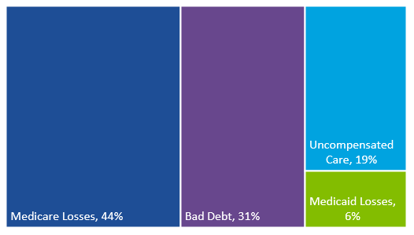
In 2024, North Carolina health systems and hospitals provided $8.5 billion of community benefits.
Community benefits come from four main sources:
  Medicare losses: when hospitals provide care to Medicare patients without full reimbursement
  Uncompensated care: free or discounted services for those who can’t pay
  Bad debt: Unpaid bills after collection attempts
  Medicaid losses: when hospitals provide care to Medicaid patients without full reimbursement
Community Benefits by Category (Percentage)
Source: HCRIS and NCHA, 2021-2024.

Slide 16
Taxes and Fees
Health systems and hospitals generate $2.5 billion in state and local tax revenue.
2025 Hospital Contributions towards NC Medicaid
Program Annual ($Millions)
Medicaid General Fund $165
Medicaid Fee-for-Service and Managed Care $707
Graduate Medical Education $77
Postpartum $19
Home and community-based services $151
States’s cost of expansion coverage $517
Total Assessments $1,636
Source: NCHA, 2026

Slide 17
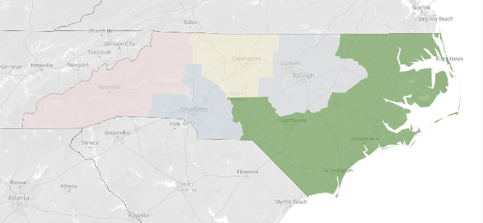
Impact Summary for North Carolina’s Eastern Region
Health System and Hospital Contributions to North Carolina’s Eastern Region, 2024
Type of Impact | Employment (Thousands) | Labor Income ($Millions) | State GDP (Value Added; $Millions) | County and Local Taxes ($Millions)
Direct | 42,578 | $4,312 | $4,764 | $24.4
Indirect | 18,819 | $921 | $1,406 | $32.7
Induced | 16,739 | $806 | $1,739 | $73.2
Total | 78,136 | $6,038 | $7,908 | $130.3
Source: RTI International analysis of HCRIS data; IMPLAN data year 2024. Values are expressed in current dollars.
Number of health systems or hospitals: 34
Average hospital employment compensation: $78,074

Slide 18
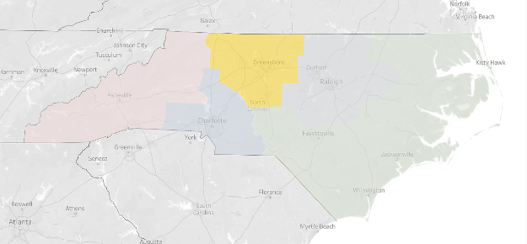
Impact Summary for North Carolina’s Central Region
Health System and Hospital Contributions to North Carolina’s Central Region, 2024
Type of Impact | Employment (Thousands) | Labor Income ($ Millions) | State GDP ($ Millions) | County and Local Taxes ($ Millions)
Direct | 40,489 | $4,013 | $4,075 | $6.6
Indirect | 22,656 | $1,408 | $2,105 | $47.7
Induced | 21,870 | $1,269 | $2,477 | $94.3
Total | 85,015 | $6,690 | $8,657 | $148.6
Source: RTI International analysis of HCRIS data; IMPLAN data year 2024. Values are expressed in current dollars.
Number of health systems or hospitals: 17
Average hospital employment compensation: $97,796

Slide 19
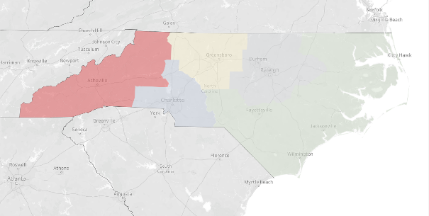
Impact Summary for North Carolina’s Western Region
Health System and Hospital Contributions to North Carolina’s Western Region, 2024
Type of Impact | Employment (Thousands) | Labor Income ($ Millions) | State GDP ($ Millions) | County and Local Taxes ($ Millions)
Direct | 22,565 | $1,968 | $2,321 | $23.4
Indirect | 12,142 | $613 | $907 | $24.3
Induced | 9,521 | $492 | $985 | $44.3
Total | 44,228 | $3,073 | $4,214 | $92.0
Source: RTI International analysis of HCRIS data; IMPLAN data year 2024. Values are expressed in current dollars.
Number of health systems or hospitals: 25
Average hospital employment compensation: $98,143

Slide 20
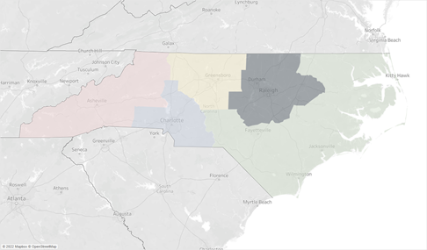
Impact Summary for North Carolina’s North Central Region
Health System and Hospital Contributions to North Carolina’s North Central Region, 2024
Type of Impact | Employment (Thousands) | Labor Income ($ Millions) | State GDP ($ Millions) | County and Local Taxes ($ Millions)
Direct | 60,129 | $6,482 | $7,588 | $66.3
Indirect | 34,976 | $2,722 | $4,156 | $86.3
Induced | 32,451 | $2,152 | $4,263 | $158.4
Total | 127,555 | $11,357 | $16,008 | $311.0
Source: RTI International analysis of HCRIS data; IMPLAN data year 2024. Values are expressed in current dollars.
Number of health systems or hospitals: 26
Average hospital employment compensation: $73,246

Slide 21
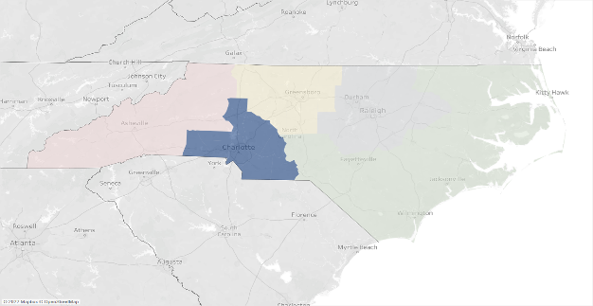
Impact Summary for North Carolina’s Southwest Region
Health System and Hospital Contributions to North Carolina’s Southwest Region, 2024
Type of Impact | Employment (Thousands) | Labor Income ($ Millions) | State GDP ($ Millions) | County and Local Taxes ($ Millions)
Direct | 58,013 | $5,697 | $6,237 | $39.3
Indirect | 25,462 | $2,073 | $3,172 | $62.8
Induced | 23,783 | $1,655 | $3,251 | $119.3
Total | 107,257 | $9,425 | $12,660 | $221.3
Source: RTI International analysis of HCRIS data; IMPLAN data year 2024. Values are expressed in current dollars.
Number of health systems or hospitals: 32
Average hospital employment compensation: $77,717

Slide 22
References

Slide 23
References
Centers for Medicare & Medicaid Services. (2025). National Health Expenditure Accounts Fact Sheet. Retrieved from https://www.cms.gov/data-research/statistics-trends-and-reports/national-health-expenditure-data/nhe-fact-sheet
Centers for Medicare & Medicaid Services. (2020–2024). Healthcare Cost Report Information System.
IMPLAN Group LLC. (2024). IMPLAN® Model [Data and software]. Huntersville, NC: IMPLAN Group LLC. Retrieved from https://implan.com/
North Carolina Health Association. (2026). Who We Are. Retrieved from https://www.ncha.org/about-us/who-we-are/
North Carolina Department of Commerce. (n.d.). North Carolina’s Official Labor Market Data Source. Retrieved from https://d4.nccommerce.com/
U.S. Bureau of Labor Statistics. (2024). Quarterly Census of Employment and Wages. Retrieved from https://www.bls.gov/CEW/
U.S. Census Bureau. (2026). Metropolitan and Micropolitan Statistical Area Delineation Files. Retrieved from https://www.census.gov/programs-surveys/metro-micro/about/delineation-files.html
U.S. Department of Labor. (2026). Occupational Employment and Wage Statistics. Retrieved from https://www.bls.gov/oes/current/naics4_622100.htm

Slide 24
Appendix A: Construction Impacts

Slide 25
Construction Impact Summary for North Carolina
Health System and Hospital Construction Contributions to North Carolina’s Economy, 2024
Type of Impact | Employment (Thousands) | Labor Income ($ Millions) | State GDP ($ Millions) | State Taxes ($ Millions)
Direct | 224,000 | $22,471 | $24,985 | $26.9
Indirect | 126,000 | $8,747 | $13,262 | $11.6
Induced | 114,000 | $6,968 | $13,897 | $18.3
Total | 464,000 | $38,186 | $52,144 | $56.8
Source: RTI International analysis of HCRIS data; IMPLAN data year 2024. Values are expressed in current dollars.

Slide 26
Impact Summary for North Carolina’s Eastern Region
Health System and Hospital Construction Contributions to North Carolina’s Eastern Region, 2024
Type of Impact | Employment (Thousands) | Labor Income ($ Millions) | State GDP ($ Millions) | County and Local Taxes ($ Millions)
Direct | 1,662 | $86.4 | $103.2 | $2.8
Indirect | 219 | $12.0 | $20.2 | $0.8
Induced | 320 | $15.4 | $33.2 | $1.40
Total | 2,201 | $113.8 | $156.6 | $4.9
Source: RTI International analysis of HCRIS data; IMPLAN data year 2024. Values are expressed in current dollars.

Slide 27
Impact Summary for North Carolina’s Central Region
Health System and Hospital Construction Contributions to North Carolina’s Central Region, 2024
Type of Impact | Employment (Thousands) | Labor Income ($ Millions) | State GDP ($ Millions) | County and Local Taxes ($ Millions)
Direct | 1,399 | $89.2 | $104.8 | $2.2
Indirect | 227 | $15.7 | $25.0 | $0.8
Induced | 425 | $24.7 | $48.1 | $1.8
Total | 2,050 | $129.6 | $177.9 | $4.8
Source: RTI International analysis of HCRIS data; IMPLAN data year 2024. Values are expressed in current dollars.

Slide 28
Impact Summary for North Carolina’s Western Region
Health System and Hospital Construction Contributions to North Carolina’s Western Region, 2024
Type of Impact | Employment (Thousands) | Labor Income ($ Millions) | State GDP ($ Millions) | County and Local Taxes ($ Millions)
Direct | 710 | $36.6 | $43.8 | $1.2
Indirect | 103 | $5.9 | $9.6 | $0.4
Induced | 158 | $8.1 | $16.3 | $0.7
Total | 971 | $50.6 | $69.7 | $2.3
Source: RTI International analysis of HCRIS data; IMPLAN data year 2024. Values are expressed in current dollars.

Slide 29
Impact Summary for North Carolina’s North Central Region
Health System and Hospital Construction Contributions to North Carolina’s North Central Region, 2024
Type of Impact | Employment (Thousands) | Labor Income ($ Millions) | State GDP ($ Millions) | County and Local Taxes ($ Millions)
Direct | 2,365 | $191.1 | $232.3 | $2.5
Indirect | 361 | $30.9 | $51.0 | $1.7
Induced | 775 | $51.4 | $101.8 | $3.8
Total | 3,501 | $273.3 | $385.1 | $7.9
Source: RTI International analysis of HCRIS data; IMPLAN data year 2024. Values are expressed in current dollars.

Slide 30
Impact Summary for North Carolina’s North Southwest Region
Health System and Hospital Construction Contributions to North Carolina’s Southwest Region, 2024
Type of Impact | Employment (Thousands) | Labor Income ($ Millions) | State GDP ($ Millions) | County and Local Taxes ($ Millions)
Direct | 3,071 | $259.5 | $311.1 | $3.7
Indirect | 526 | $46.8 | $75.8 | $2.3
Induced | 943 | $65.6 | $128.8 | $4.7
Total | 4,540 | $371.9 | $515.7 | $10.7
Source: RTI International analysis of HCRIS data; IMPLAN data year 2024. Values are expressed in current dollars.

